Slide 1
At the Intersection of Weather and Climate
The NOAA Research Global-Nest Initiative
A multi-center, public-private-academic collaboration between
GFDL, AOML, NSSL, GSL, Princeton CIMES, EMC, and AI2
Lucas Harris
UFS Webinar, 13 April 2023

Slide 2
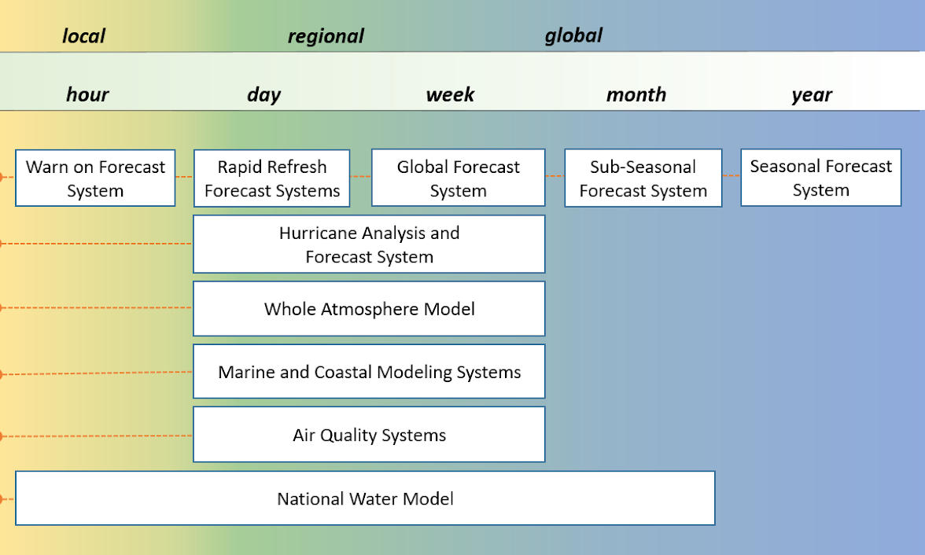

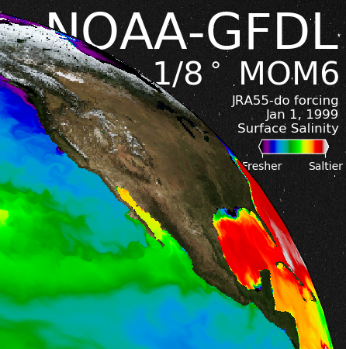
NOAA Minutes-to-Millennia Unified Modeling
Unified Forecast System
GFDL Seamless Modeling Suite
FMS

Slide 3
Starting in FY22, Congress has directed NOAA Climate Research Labs and Cooperative Institutes to initiate the development of a global-nested high-resolution atmospheric model, as part of Climate Change Adaptation and Resilient Infrastructure.
The NOAA Research Global-Nest Initiative was formed in 2022 to carry out this directive as a multi-institution effort, leveraging existing development in the UFS and SMS

Slide 4
The NOAA Research Global-Nest Initiative aims to develop storm-scale holistic, seamless digital twins of the earth system for prediction, projection, and understanding of extreme weather events, and to create actionable information at all time scales.
Global-nested medium-range & S2S predictions
Kilometer-scale global storm-resolving simulations
Sub-kilometer multi-nest and process model
The Global-Nest Initiative directly benefits UFS and SMS development.
https://www.gfdl.noaa.gov/noaa-research-global-nest-initiative/

Slide 5

Global-Nest Technologies
SHiELD
FMS
& Pace

Slide 6


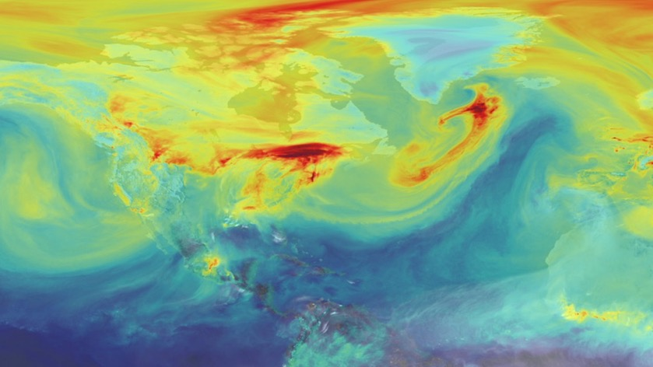
FV3
The GFDL Finite-Volume Cubed-Sphere Dynamical Core
FV3 is the fluid solver (“engine”) for a community of atmosphere models
  Accurate numerics
  Computationally
  efficient
  Flexible solver
  and interface
  Timely Forecasts
  Accelerated Development
  Ultra high-resolution models
  Many applications
Worldwide
FV3 Community
GFDL Seamless Modeling
Unified Forecast System
NASA GEOS + Mars GCM
Harvard GEOS-Chem
CESM and others
Open Development
”A good model must be a fast model”—S-J Lin
Carbon Dioxide in FV3-Based NASA GEOS
https://svs.gsfc.nasa.gov/11719

Slide 7
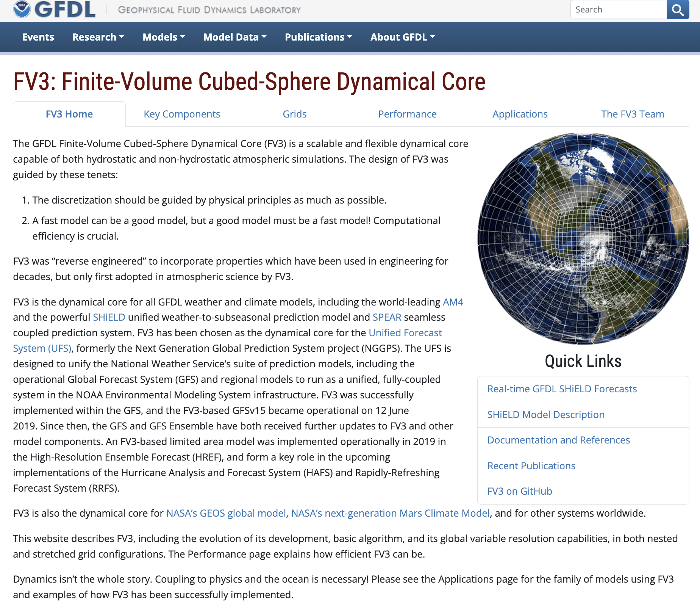
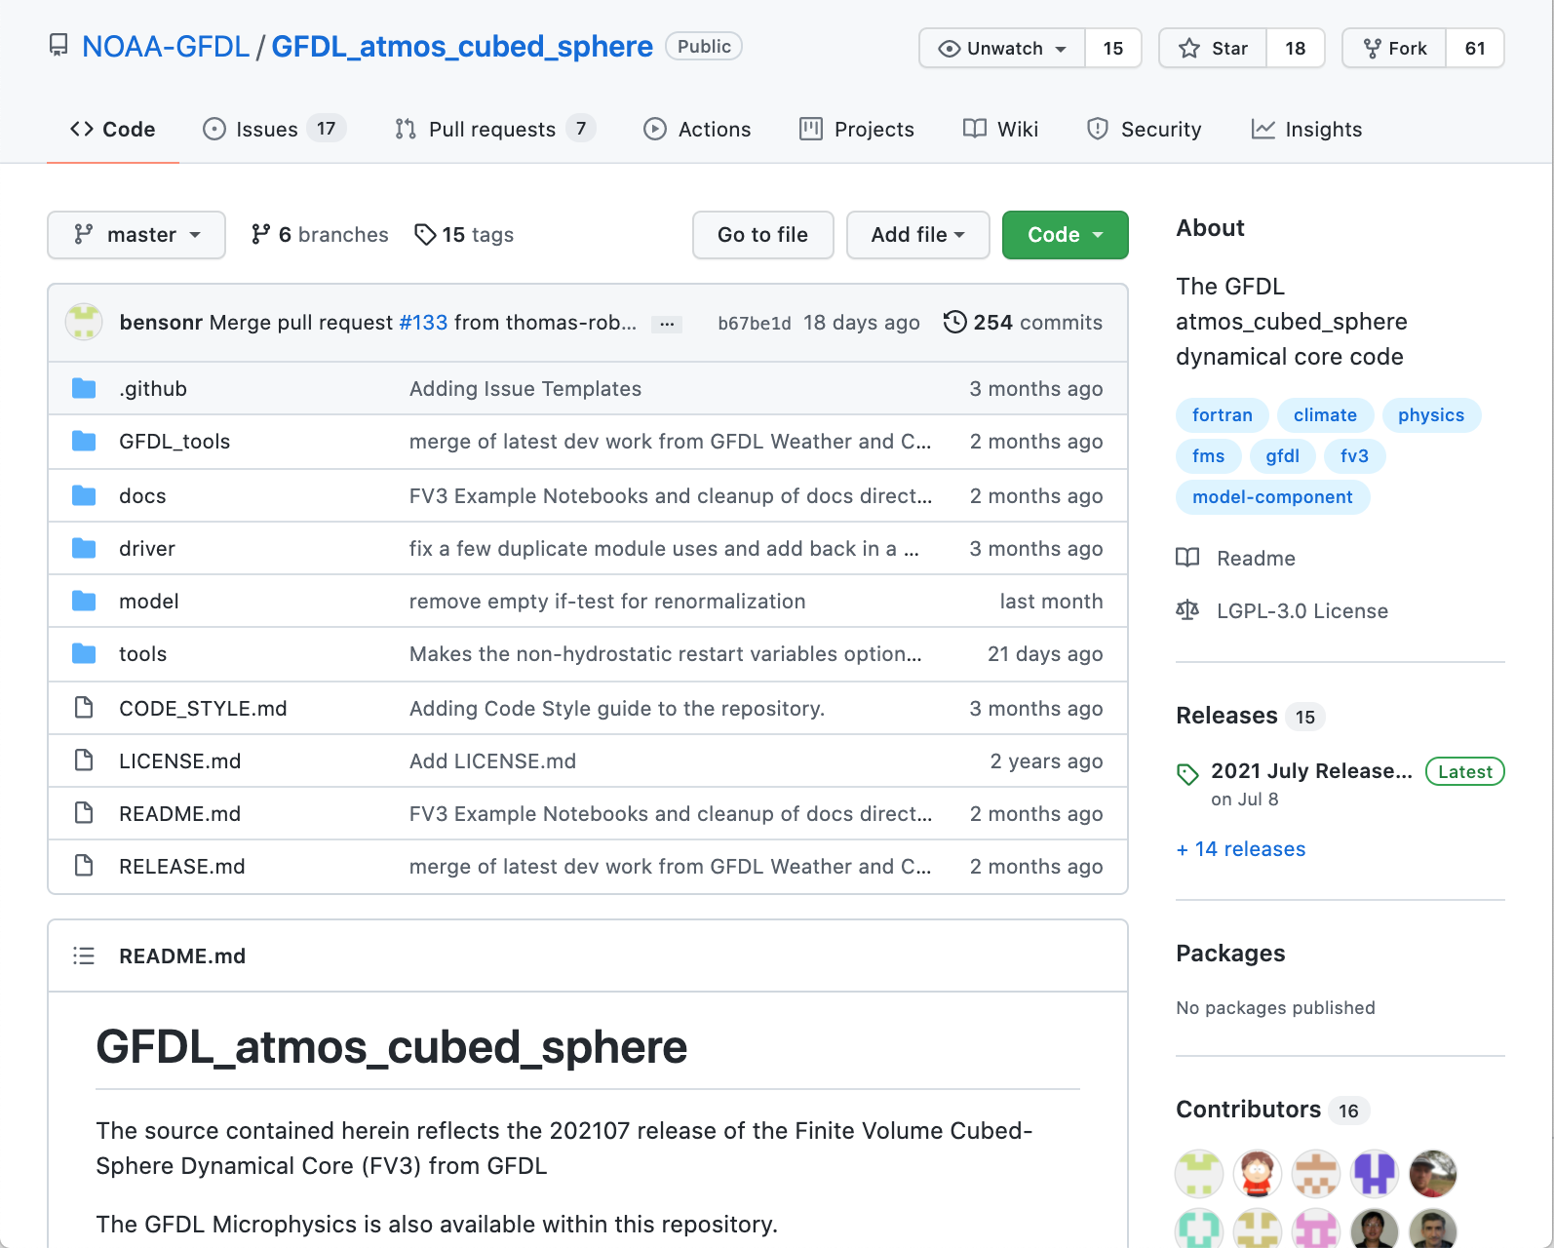
FV3 Community Resources
FV3 Portal
www.gfdl.noaa.gov/fv3
FV3 Community GitHub
github.com/NOAA-GFDL/GFDL_atmos_cubed_sphere
Notes:
FV3 Portal: Central location for FV3 information including publications, scientific documentation, use cases
Github: Official site for releases, examples, issue tracking, documentation, and more.

Slide 8
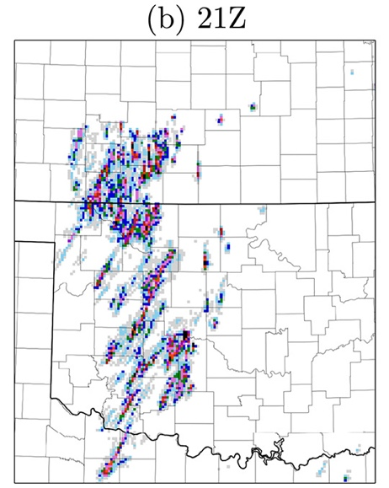
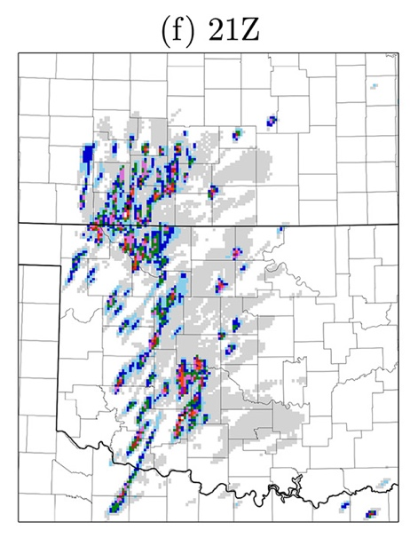

Seamless Modeling: Vorticity Dynamics
C-SHiELD (3-km US nest) Oklahoma severe weather
16 May 2017
GFDL CM2.0: B-Grid Core
GFDL CM2.1: FV
Hourly-Maximum
UH (w x ζ, m²s⁻²)
Hourly-Maximum
column-max w (m¹s⁻¹)
Zonal-mean
wind stress:
CM2.0 vs. CM2.1
Harris et al. 2019, JAMES
Global-mean Ocean Temp diff.
(K) in control-climate integrations
Delworth et al. 2006 JClim

Slide 9
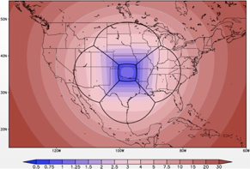
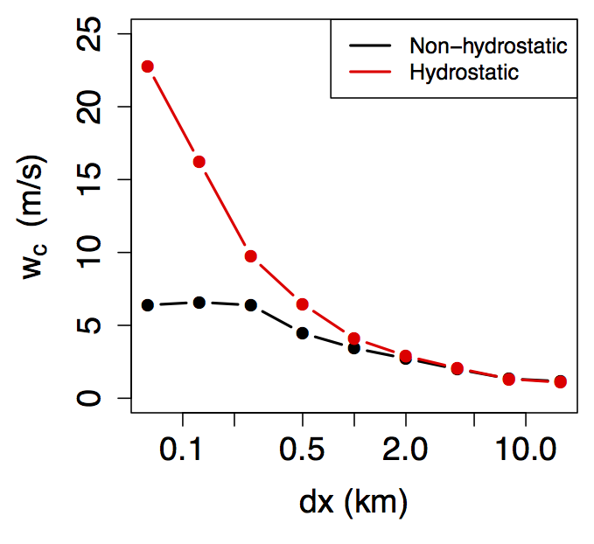
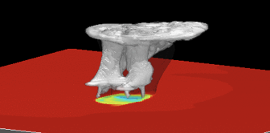
Seamless Idealized Convection and
Radiative-Convective Equilibrium
Parcel width (∆x)
At ∆x = 250 m
convection
is fully resolved
(as per G. Bryan, NCAR)
Mean updraft w
Jeevanjee, 2017, JAMES
Anber et al, 2018, JAMES
Arnold and Putman (NASA),
2018, JAMES
Tornado-like vortices in super-stretched (c256r40) global model
Doubly-periodic domain for RCE/LES
in the same modeling framework
Cheng and Harris, in prep.
Notes:
A powerful tool for process modeling!

Slide 10
FV3 Ongoing Development
Duo-Grid & LMARS
  GFDL; WPO-funded
Advanced nesting: telescoping, moving, and vertical nests
  GFDL, AOML, GSL; HurrSup-funded
Super-regular regional domain
  EMC & GSL; HurrSup-funded
Whole and deep atmospheres
  EMC & SWPC
Integrated physics
  GFDL, AOML, EMC
  WPO + STI-funded
New advection and vertical remapping operators
  GFDL
Semi-implicit solver revisions
  GFDL + EMC
Subgrid turbulence
  GFDL, Clemson, FIU, AOML
  JTTI-funded
GitHub CI/CD
  GFDL; UFS R2O funded
FV3 Adjoint
  GMAO & JSCDA
“A key element that makes collaborations successful is having individuals who enjoy working together and are able to do so.”—Morris Bender, BAMS 2019

Slide 11
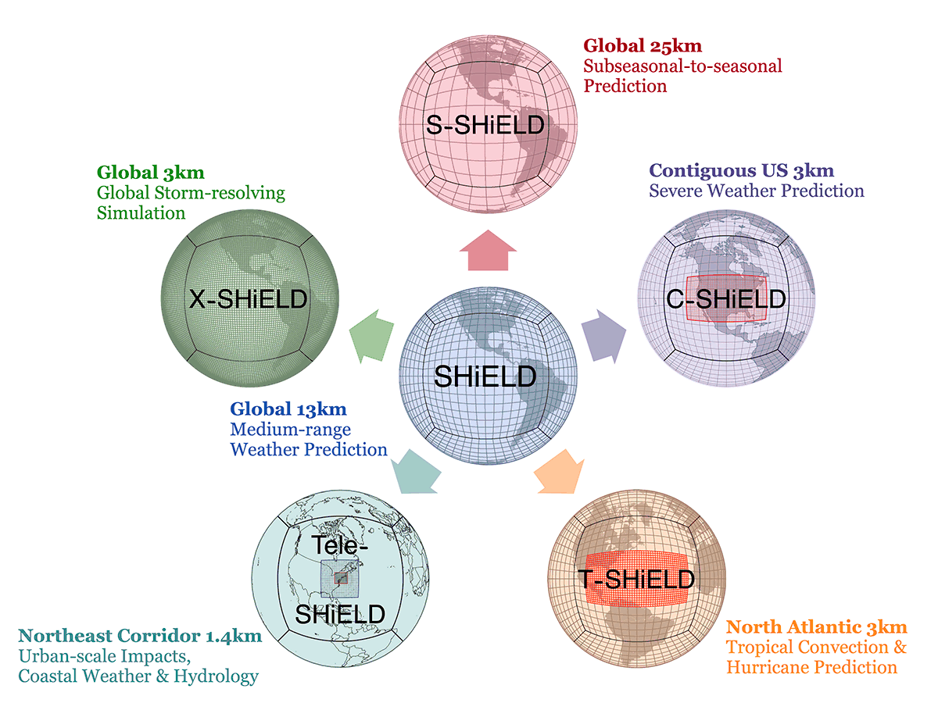
SHiELD
System for High-resolution prediction
on Earth-to-Local Domains
Images courtesy
Linjiong Zhou, Kai-Yuan Cheng,
Kun Gao, and Jan-Huey Chen

Slide 12
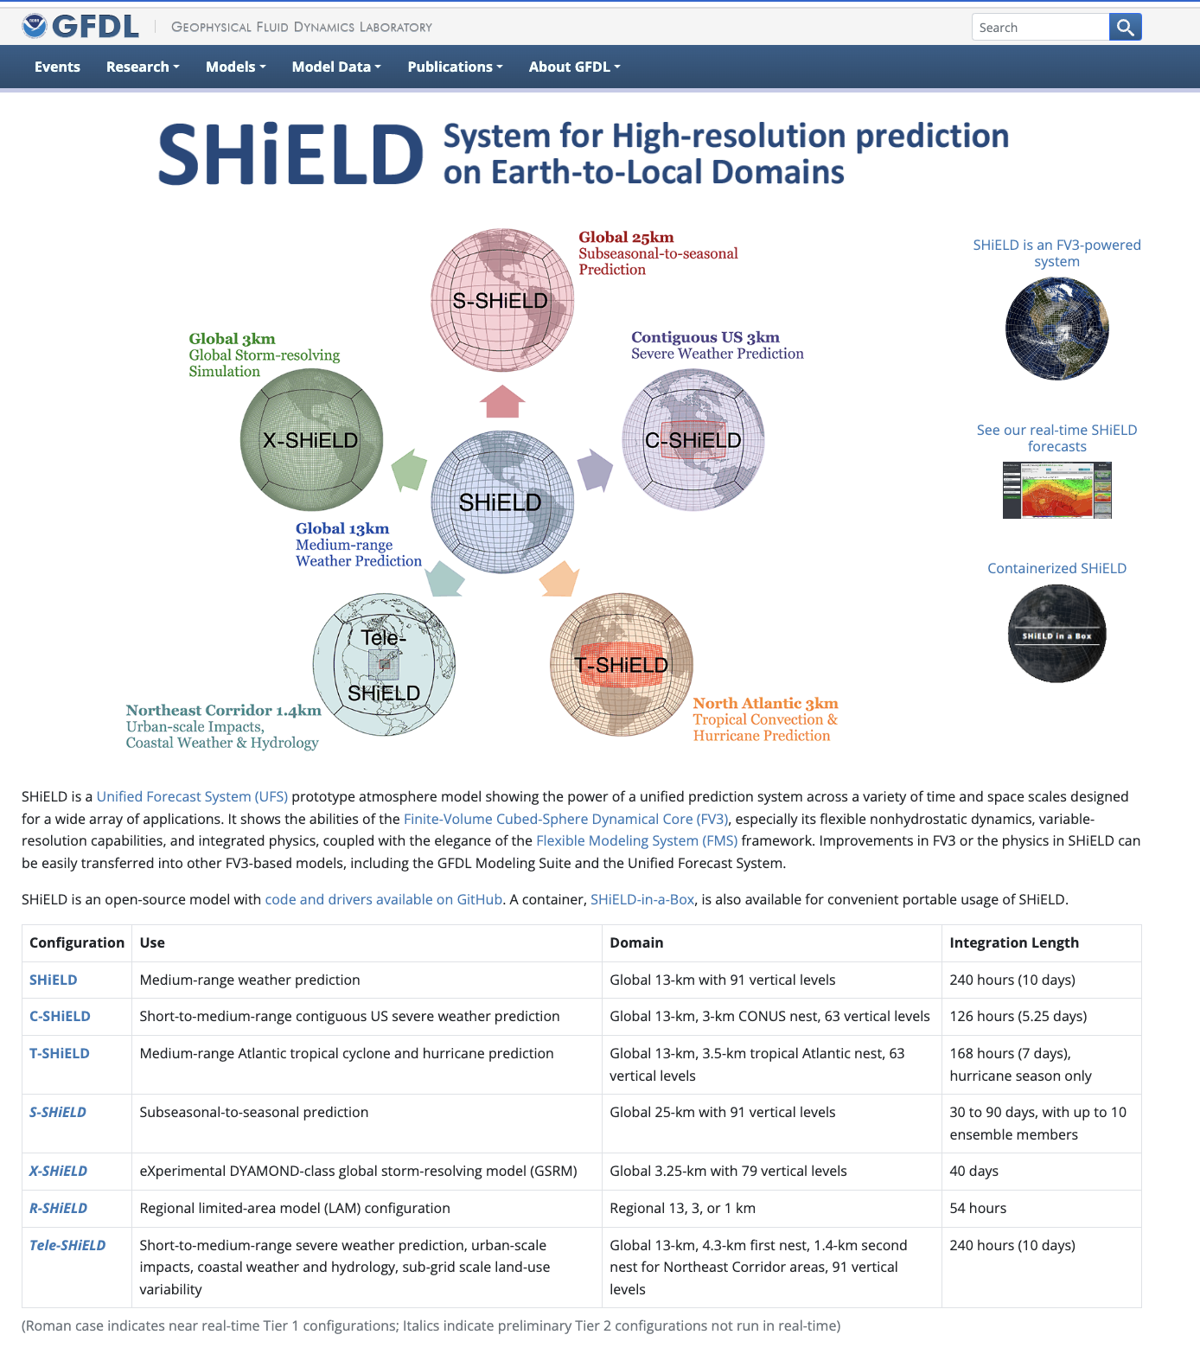
SHiELD philosophy and development
One code, one executable, one workflow
Demonstrate new capabilities and applications in FV3 and physics
Seamlessly unified within UFS & SMS
  Extended version of GFS/MRW physics
Holistic seamlessness—yearly updates help improve all configurations
Intercomparisons and testbeds:
  DYAMOND, Dimosic, HWT SFE, HREx
“Incremental improvements every year turn into profound improvements over 3–4 years…It adds up.”
— John Gruber, Daring Fireball
www.gfdl.noaa.gov/shield
Notes:
Building on the powerful GFS legacy of Hua-Lu Pan and Joe Sela
Fanglin, Jun et al. doing really great work

Slide 13
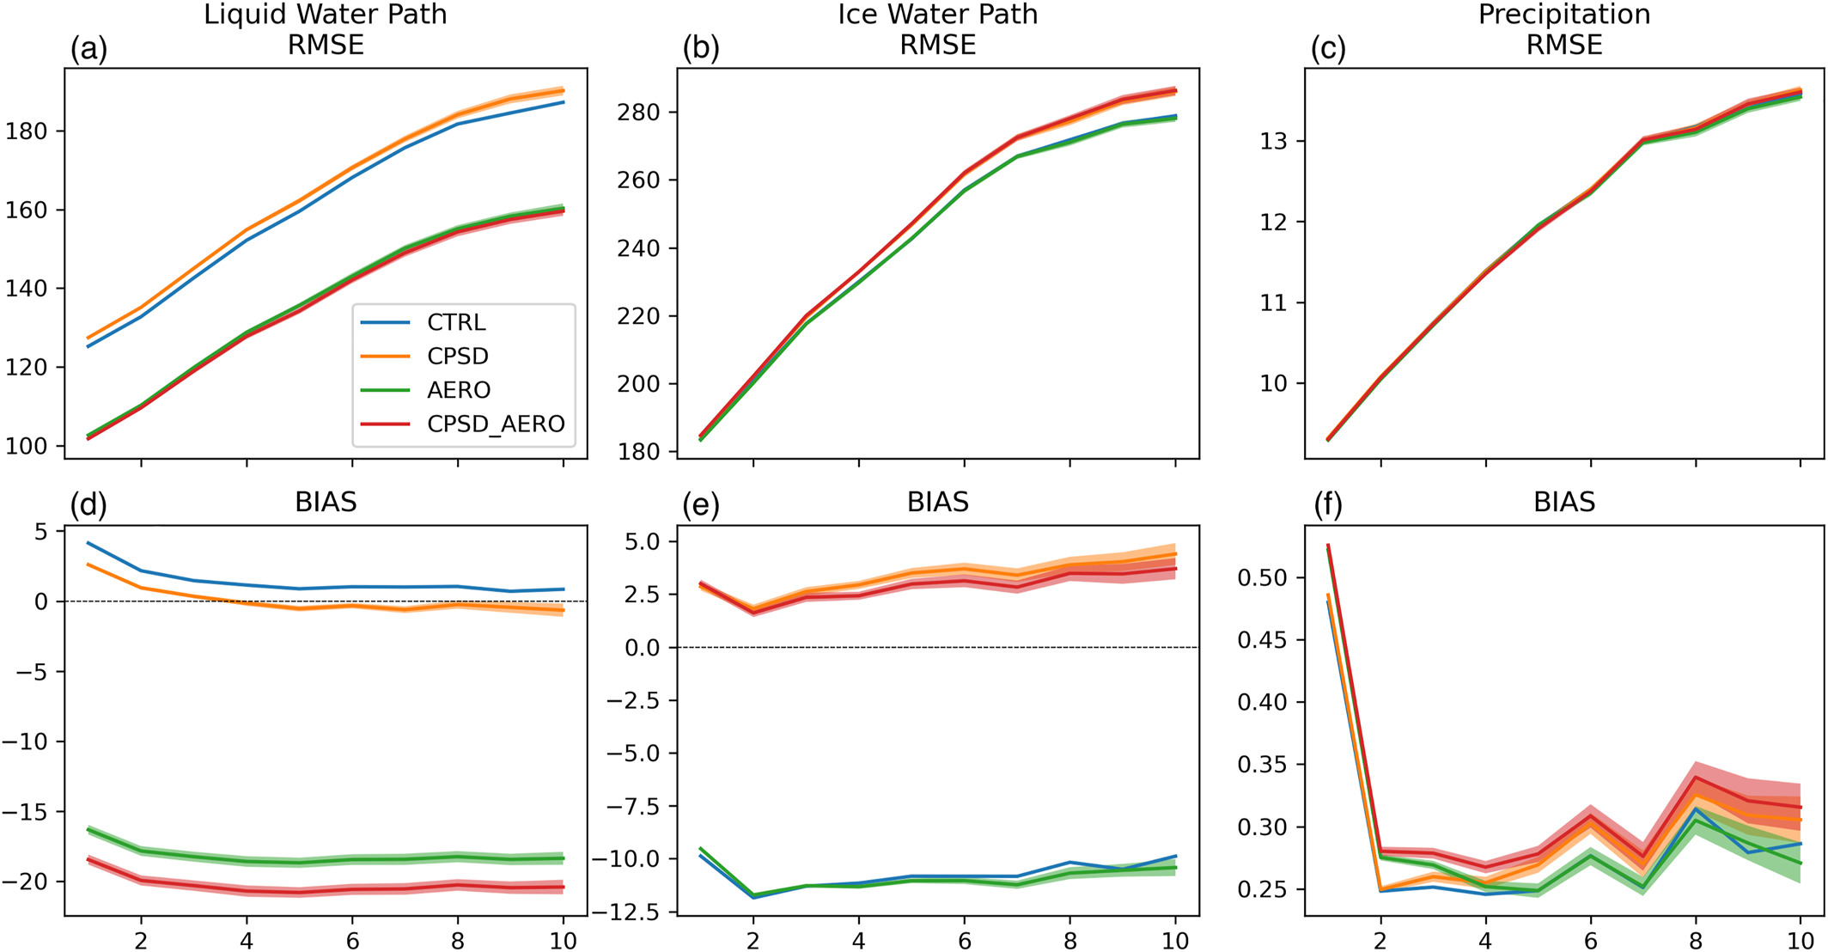
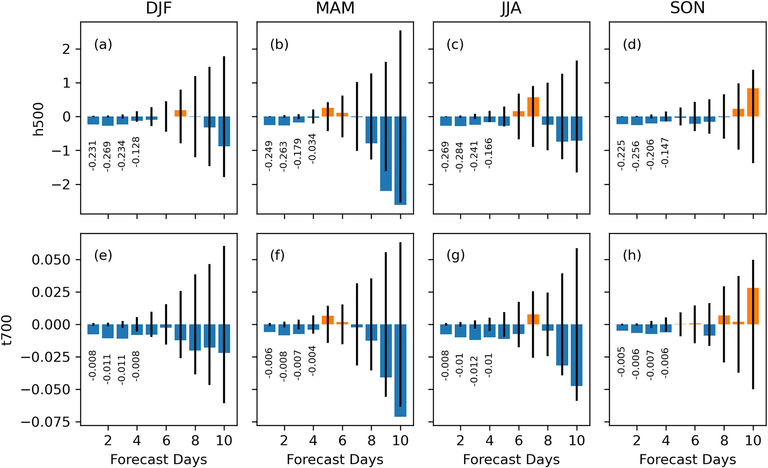
GFDL Microphysics v3: Improving weather forecasts by improving clouds and radiation
WPO-funded project to improve hurricane microphysics
GFDL-AOML-PNNL-HUJI Collaboration
RMSE change for h500 and t700 for GFDL MP v3
with realistic background aerosol (AERO-CTL)
L Zhou et al. (2022, JAMES)
Notes:
“Climate thinking”

Slide 14
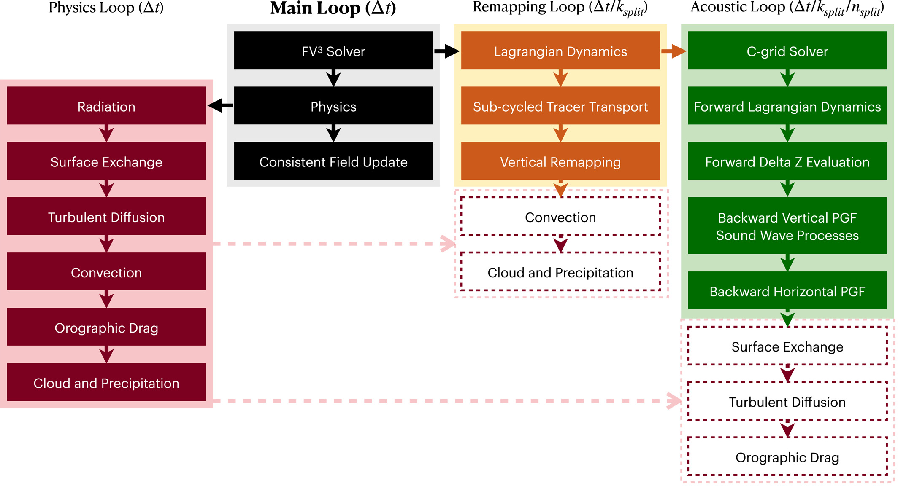
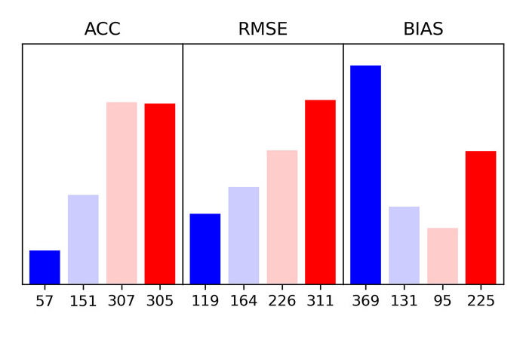
FV3 Integrated Physics
A radical re-imagining of physics-dynamics coupling
Integrated physics gives consistent energetics, thermodynamics, and computational loading,
while introducing
physically-correct timescales.
Integrated physics
in SHiELD (proposed)
Global Scorecard:
13-km SHiELD w/
Inline GFDL MP
vs. Split GFDL MP
Next Step: 6.5-km SHiELD
Zhou and Harris, 2022 GRL

Slide 15
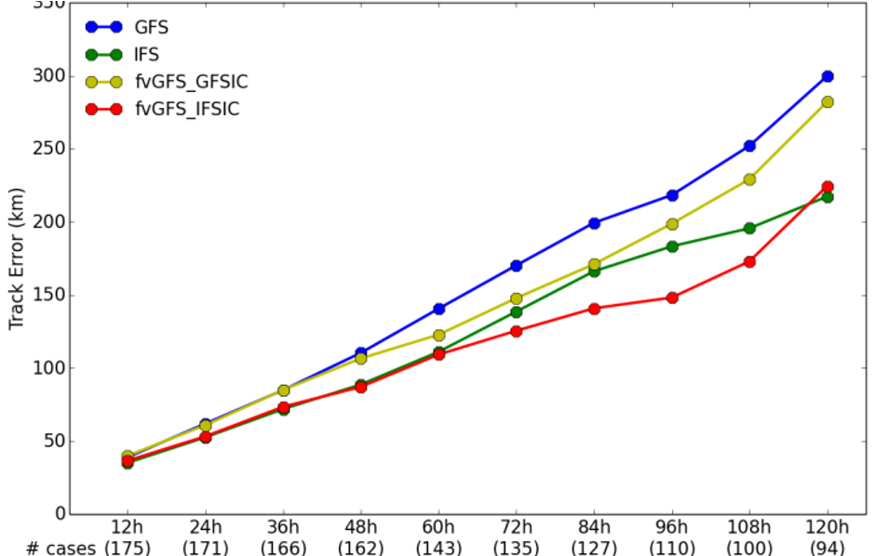
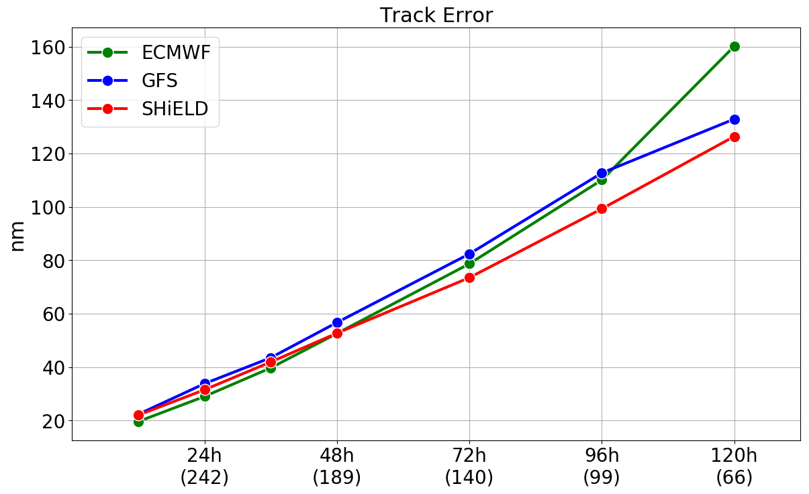
SHiELD R2O: Improving Hurricane Forecasts
2017 TC Track Error
(lower is better)
2021-2022
Mean Atlantic TC Track Error
Euro
Legacy US GFS
GFDL SHiELD
SHiELD + Euro data
Operational
Transition
+
Improved
US Data
Better Model
Better Data
Chen et al. (2019 GRL)
Courtesy Kun Gao and Jan-Huey Chen
Better Model + Better Data ⇒ US #1 for Tropical Cyclone Track Forecast

Slide 16
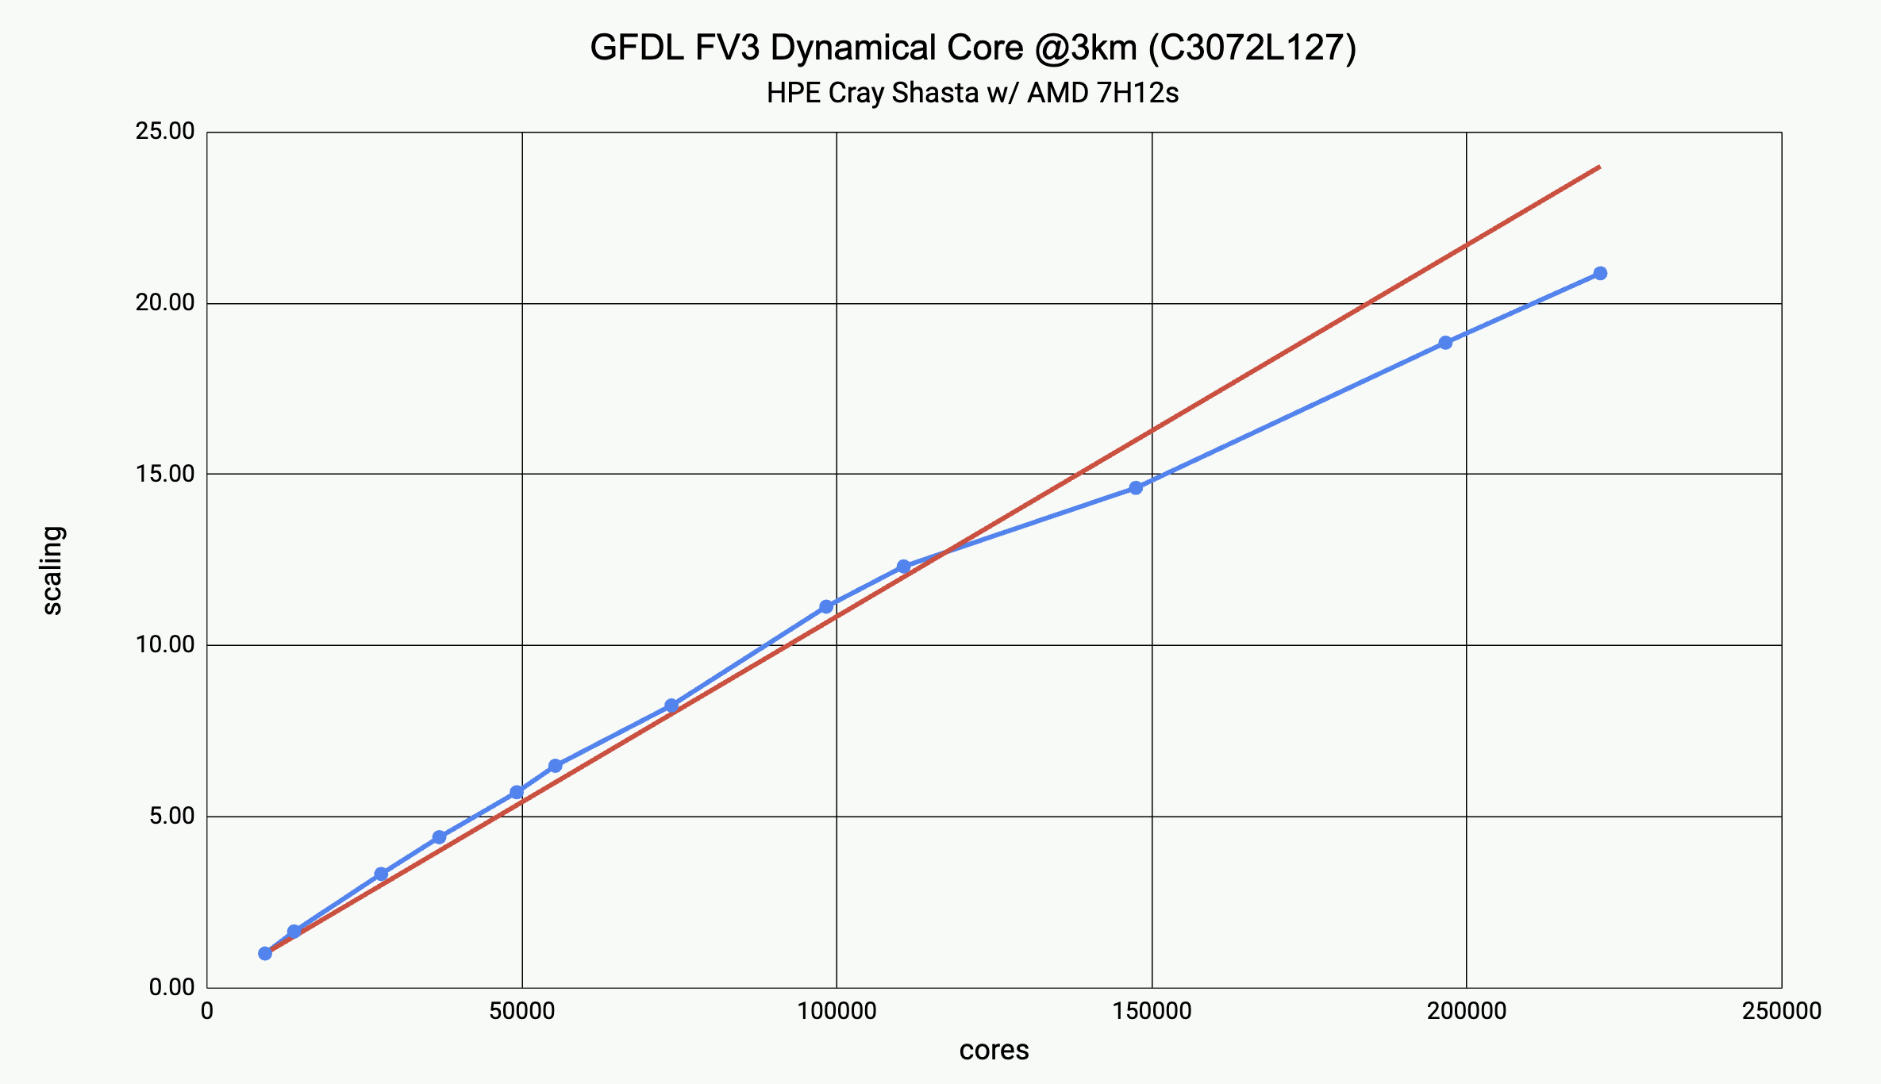
FMS + FV3 scaling
197 days/day
7.3 min/day!
85 days/day
2012: Scaling of 3.5-km HiRAM on Argonne BlueGene Q
https://www.alcf.anl.gov/files/anl_05_16_2013_0.pdf
2023: Scaling of 3.25-km FV3 solo_core on Gaea C5
Courtesy Rusty Benson

Slide 17








AI2 Pace
Accelerating to k-scale
The CPU-MPI era is (?) ending
GT4py Domain Specific Language (DSL)
Model re-written in Python and compiled to optimized code for any processor
  GridTools in operations at MeteoSwiss
  Evaluation underway by ECMWF and MPI
Pace: GT4py implementation of FV3GFS
Performance + Python Flexibility
Transitioned into NOAA + NASA
SENA-funded NOAA efforts at GFDL + GSL
Python user code
DSL Frontend (GT4Py)
DSL Compiler
Checkers
Optimizers
Code Generators
Python
CPU Compiler
GPU Compiler
Flowchart courtesy Oliver Elbert
Notes:
NASA has ported GT4py FV3 into GEOS
Pace: DSL + Python-wrapped model instrumented for ML applications
Python wrapper is super cool! Powerful prototyping, debugging, instrumentation, diagnostics, unit testing, plug-ins (ML!) and more!
Technology transition to NOAA underway

Slide 18
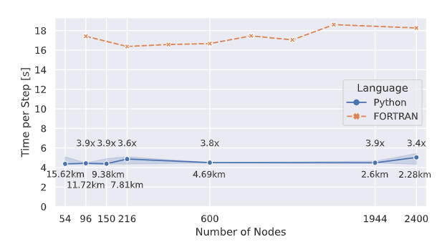
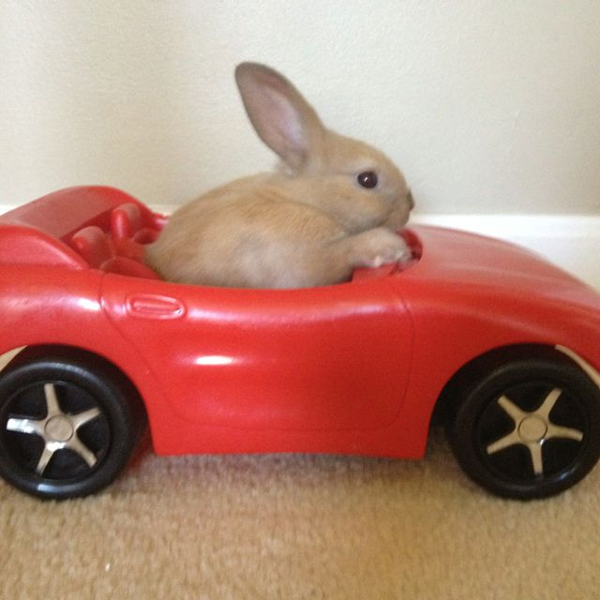
Pace FV3
2.6 km Pace
0.12 SYPD!
Ben-Nun et al., arXiv:2205.04148v1
Plot courtesy Oli Fuhrer and Oliver Elbert (AI2)
Socket-for-socket comparison on Piz Daint
(CSCS Switzerland, 12x Intel Haswell + 1 NVIDIA P100)
Pinterest user Elizabeth Chambers
Notes:
Turns our powerful truck into a real hot rod!

Slide 19
Global-Nest Applications

Slide 20
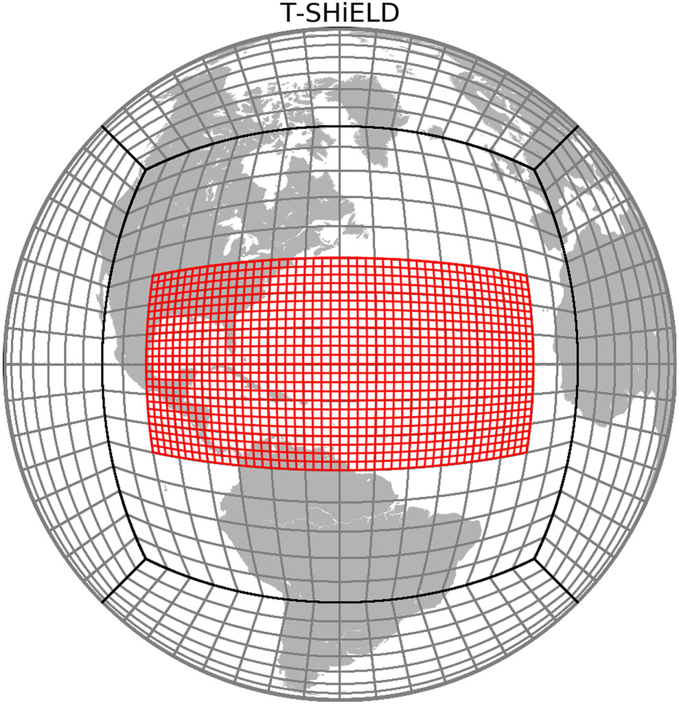
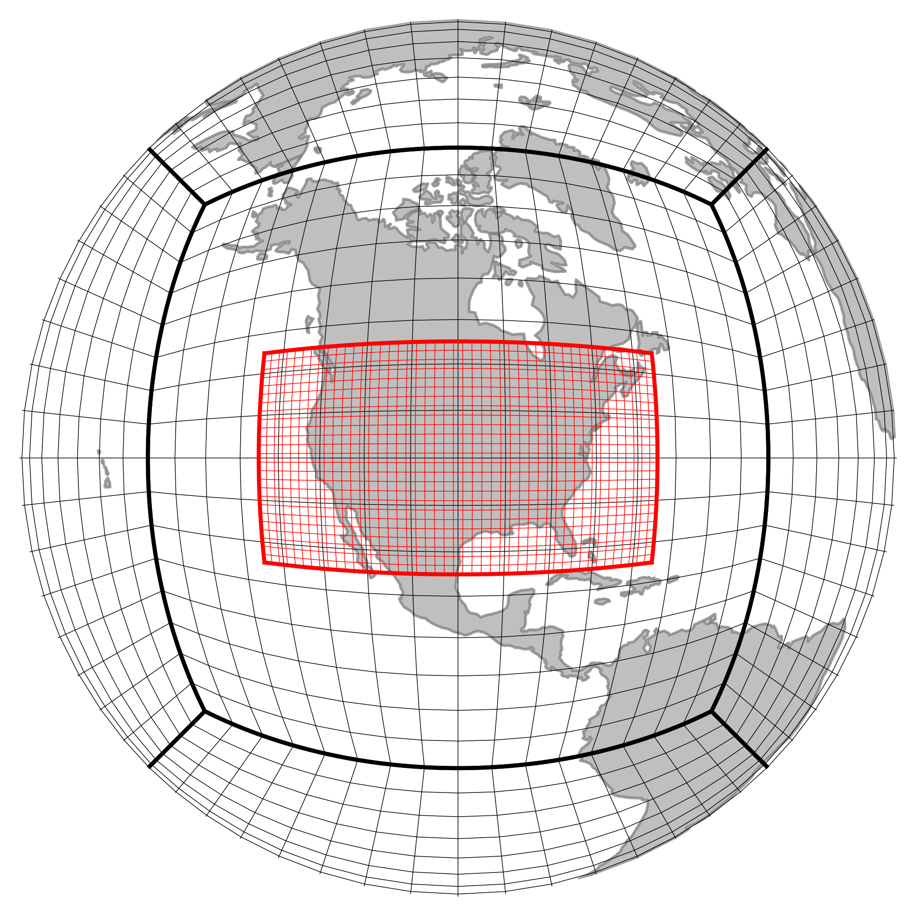
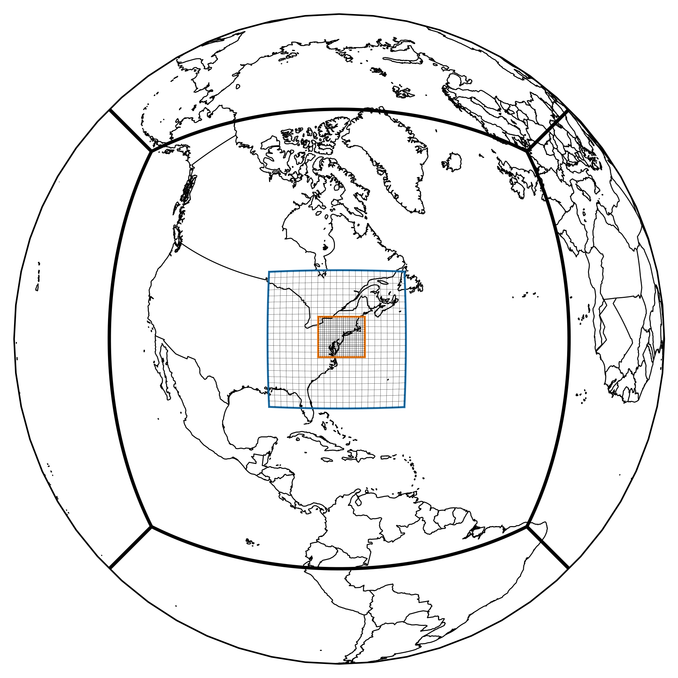
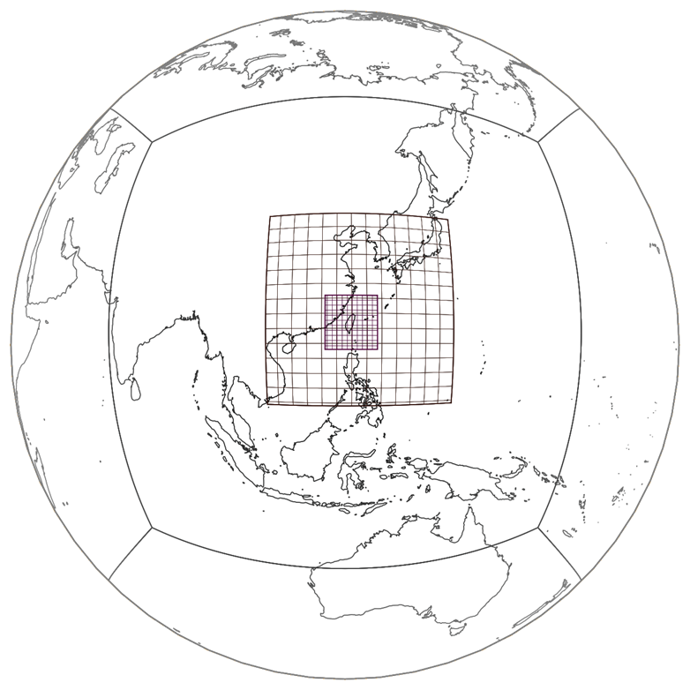
Global-to-Regional Nesting
3-km Nested
T-SHiELD
The Global-Nest Initiative is bootstrapped.
Results available from day 1.
FV3’s grid nesting allows extended-range convective-scale prediction!
Stretched FV3 another powerful option especially for chemistry + climate
  L Zhou et al 2019 BAMS
  Used extensively in GEOS and GEOS-Chem
Advances directly benefit and inform other convective-scale applications
  HAFS, RRFS, WoF, etc.
3-km Nested
C-SHiELD
1.4-km Nested
Tele-SHiELDs

Slide 21
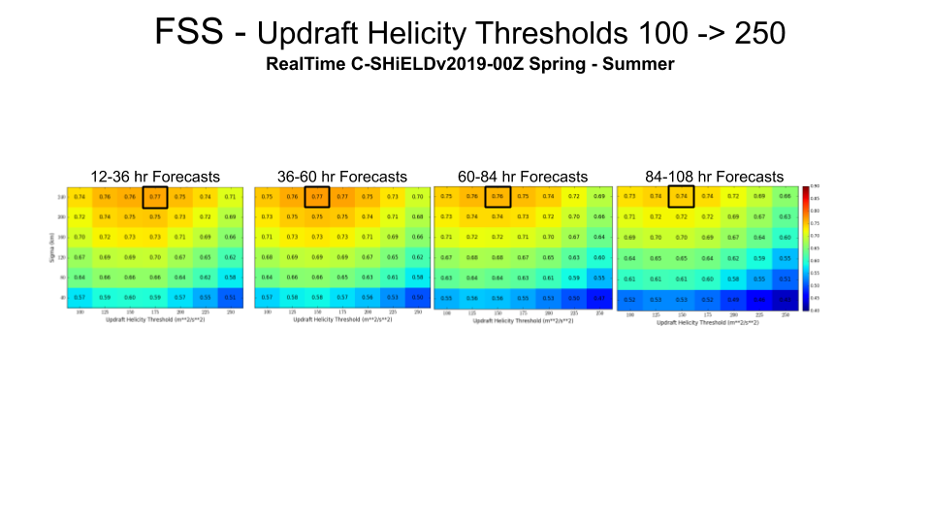
3-km Nested C-SHiELD
Medium-Range Forecasts
www.gfdl.noaa.gov/c-shield-next-generation-of-extreme-weather-prediction/
Nesting extends storm prediction into the medium range.
Surrogate severe prediction of severe storms shows similar skill on days 2–4 as on day 1.
Improvements of clouds and radiation lead to improved 500 mb skill—potential for longer ranges
2023 HWT Medium-range experiment including NCAR C-SHiELD ensemble
Harris et al. 2020, JAMES
Kaltenbaugh et al. 2022, Tech Note GFDL2022001
Notes:
Improvements to clouds and land surface in C-SHiELD (especially stratiform precip and anvils) have led to significant improvements in large-scale skill important for medium-range convective-scale prediction. This has long been appreciated in tropical convection but is a new area for continental convection. Variable-resolution models like C-SHiELD are the future of weather prediction.
Also: Goddard’s 6.5-km global model skillfully forecasts severe weather!

Slide 22
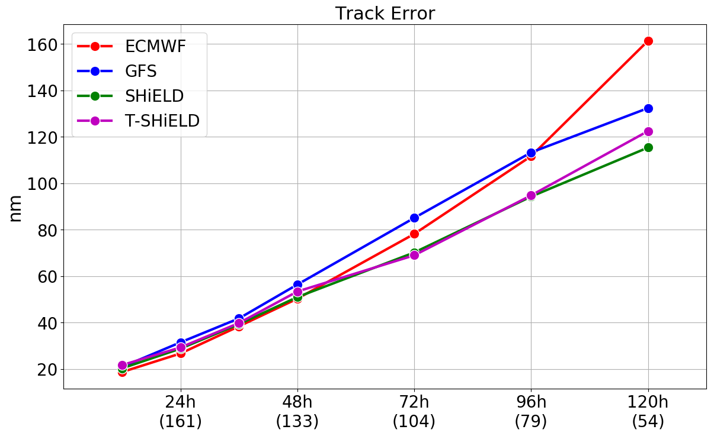
T-SHiELD Global-Nest Hurricane Forecasts
Global-Nest a natural for strongly scale-interacting TCs
3-km Nested T-SHiELD shows how explicit deep convection can control TC intensity, synoptic steering flow, and structure
Testing ground for convection-large-scale interactions and parameterized shallow cumulus
Homogeneous 2021-2022 Atlantic TC Comparison
Courtesy Kun Gao

Slide 23
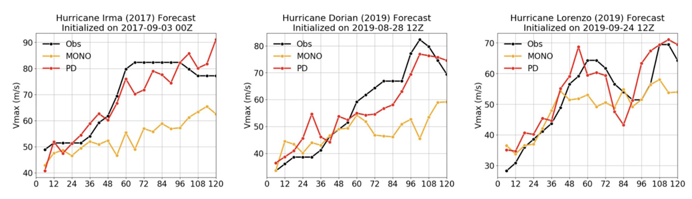
T-SHiELD Positive-Definite Advection:
Rapid Intensification and Storm Structure
Positive-definite (PD) tracer advection
➔ successful rapid intensification (RI) predictions compared to monotonic (MONO)
PD advection enables more WV into eyewall, permitting better updraft and TC structure
Framework for post-landfall TC structure validation being built
(cf. J Chen and Chavas 2023)
Gao et al 2021, JAS
Notes:
More importance of numerics

Slide 24
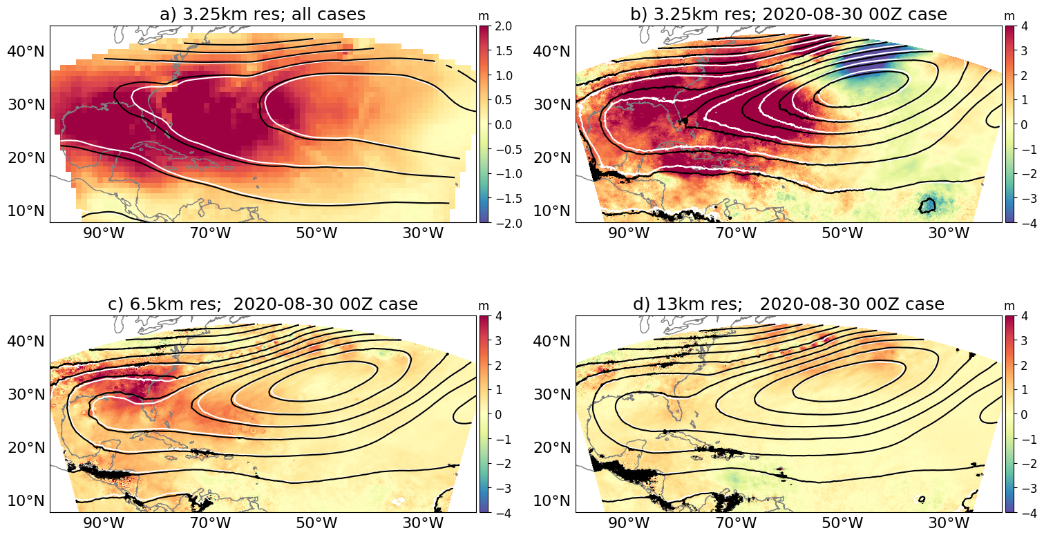
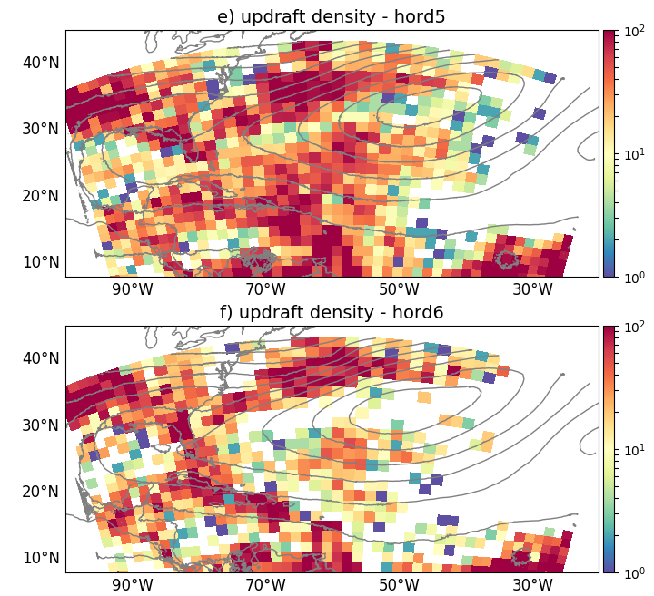
Explicit convection and synoptic circulations
Explicit convection means tuning convective heating is a lot harder!
At k-scales, dynamics settings that change updraft frequency and intensity change the synoptic steering flow.
This has direct impacts for tropical cyclone track forecasting on large k-scale domains—and for GSRMs
Effect of two advection schemes on weakly-organized convection in T-SHiELD
Gao et al.
In revision at GRL

Slide 25
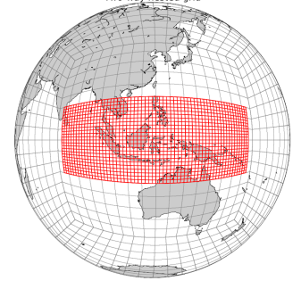
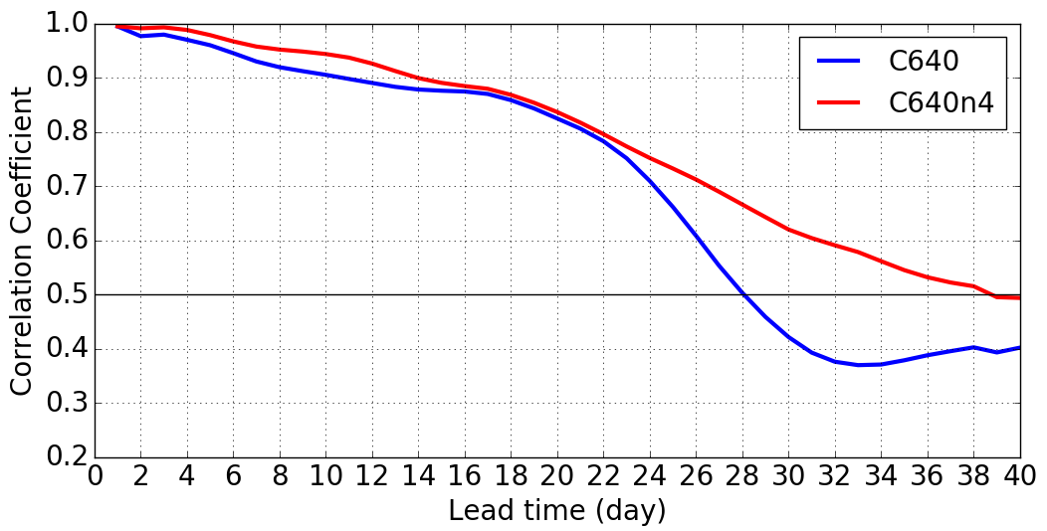
Improved MJO Forecasting by Nesting
SPEAR and SHiELD get 25+ days of MJO at 100-50-25 km resolution. Higher resolution gives better forecasts.
AOML & GFDL Collaboration:
40-day runs during DYNAMO
Maritime Continent nest gives a full 39 days of useful predictability!
Enhanced resolution improves precipitation and diurnal cycle over Maritime Continent
SHiELD global 16-km grid
4-km Maritime Continent nest
40-days in 8 hours with 4K Gaea cores
16-km Uniform
… and 4-km Nest
24 Days
26 Days
28 Days
39 Days
MJO skill (higher is better)
Zavadoff (AOML) et al., GRL, 2023
Notes:
Enhanced resolution improves MJO through better precipitation and diurnal cycle over Maritime Continent

Slide 26
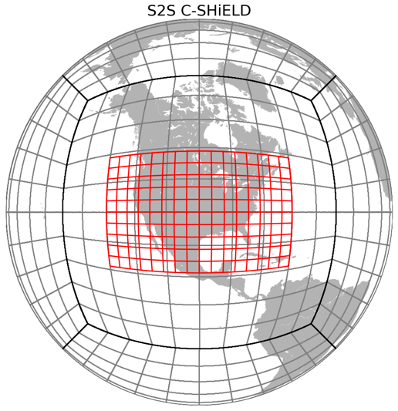
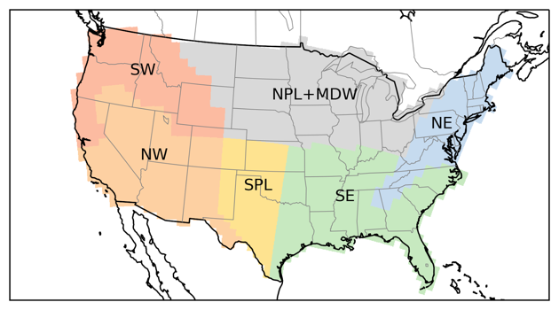
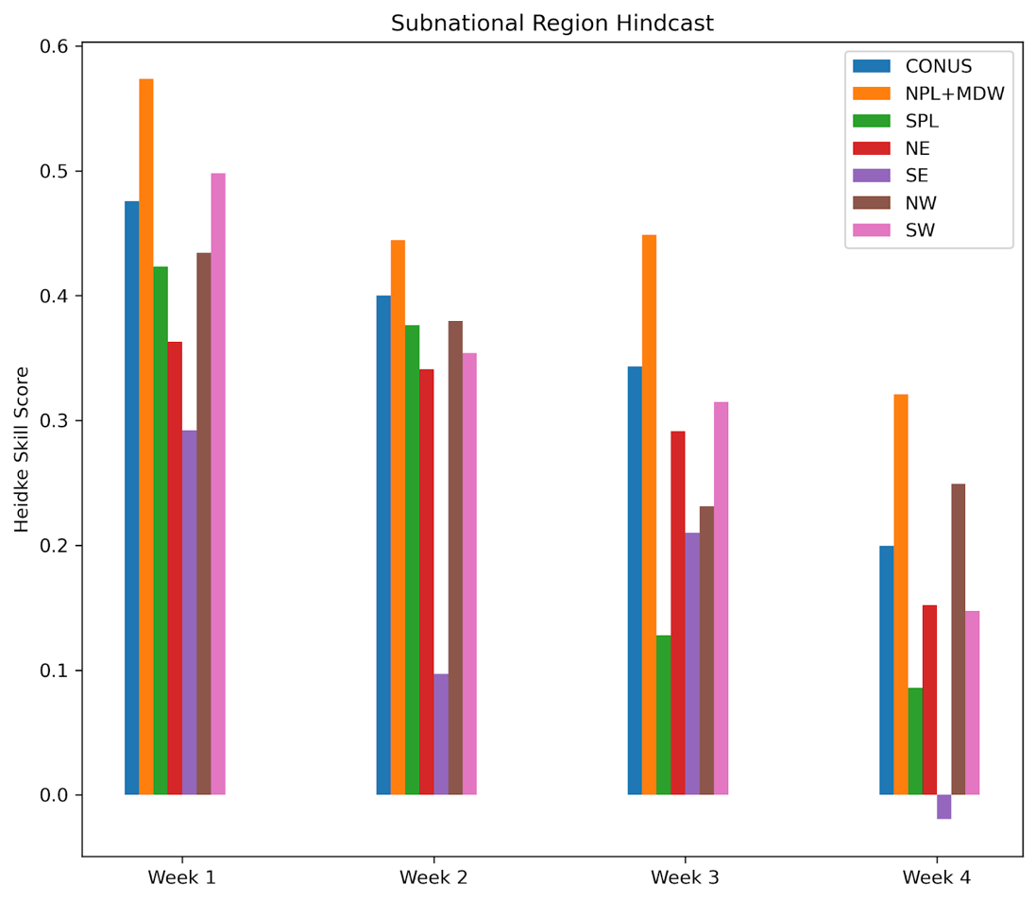
C-SHiELD Subseasonal
Severe Storm Forecasts
NW
SW
5-km nest in 16-km global model: Explicit prediction of severe thunderstorms
  30 days in 8 hours with 2112 cores
11-member 30-day forecasts for Springs 2016—2020: validate UH vs. storm reports
Promising skill in northern US out to week 3 and 4!
Collaboration with NSSL on more extensive cold-season validations
Heidke Skill Score
higher is better
Courtesy Kai-Yuan Cheng

Slide 27
X-SHiELD
Global Storm-Resolving Model
eXperimental System for High-resolution prediction on Earth-to-Local Domains

Slide 28
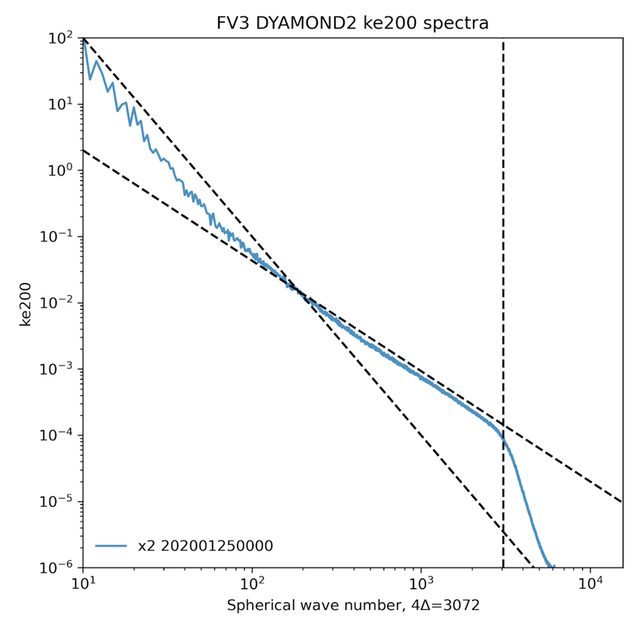
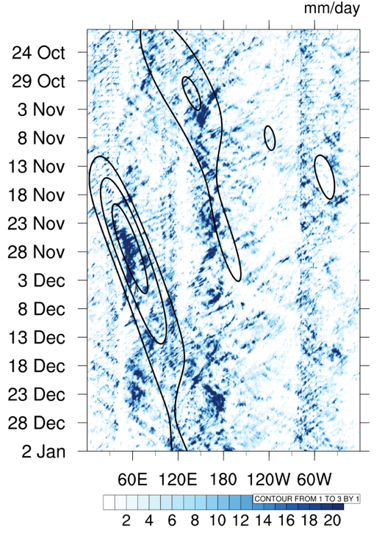
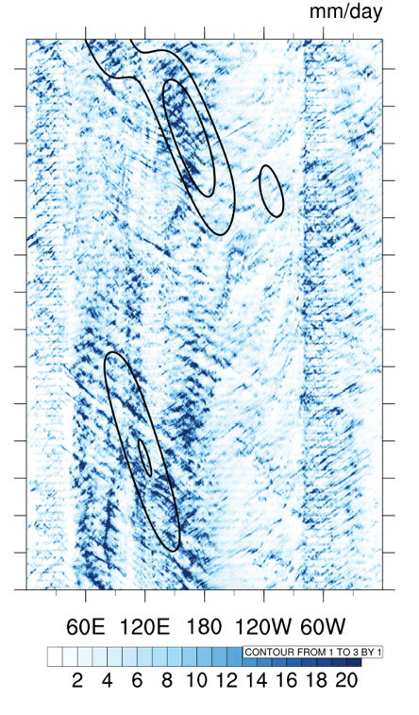
X-SHiELD
Global Storm-Resolving Model
c3072 4∆x
-3 large-scale
3.25-km global model with no deep convection parameterization
An efficient GSRM with excellent convective-scale features
  78 min/day with 13.9K cores on Gaea C4
Submitted to DYAMOND
Data becoming available on NODD
-5/3 mesoscale
“Effectively-inviscid”
dynamics
CMORPH MJO
X-SHiELD MJO
“If you keep increasing resolution but don’t make the model more complicated, I think you will have a great time.”
—Syukuro Manabe, GFDL Meteorologist 1958–1997
2021 Nobel Prize in Physics
F Zhang et al. 2019, JAS
Satoh et al. 2019, CCCR
Stephan et al. 2022, Tellus
B Stevens et al. 2019, PEPS
Judt et al. 2020, JMSJ
Courtesy Yongqiang Sun
Notes:
FV3-based NASA and GFDL GSRMs in development since 2008
Open question: What are GSRMs good for? ML is one answer; year-round tool could be a great tool for understanding convective-scale impacts on synoptic and global circulations on timescales longer than a day: important for larger domains.

Slide 29
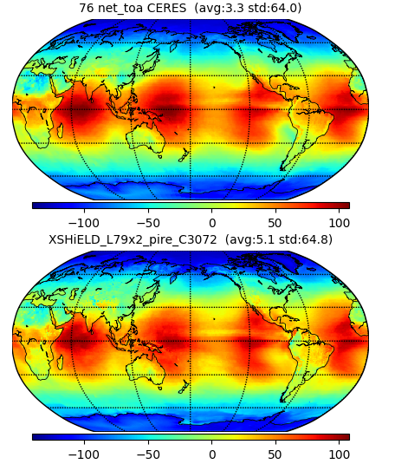
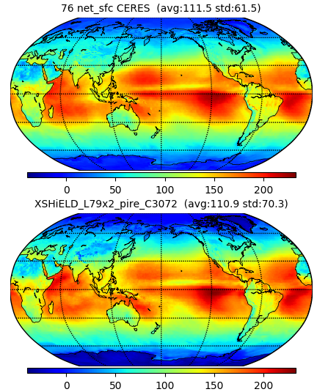
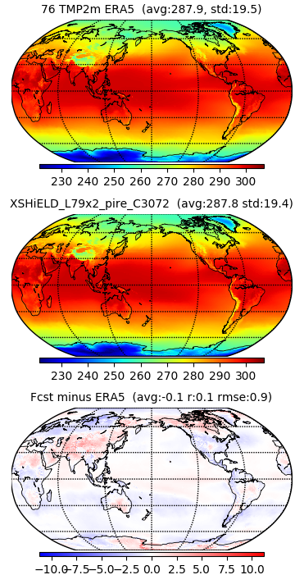
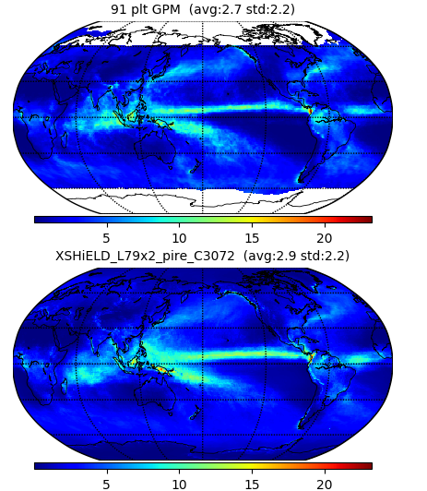
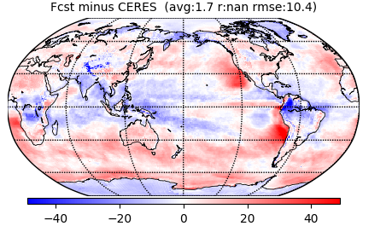
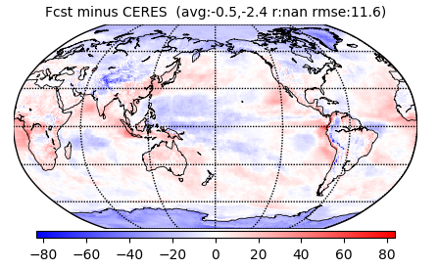
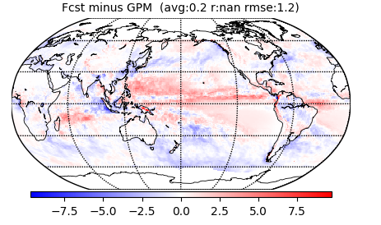
Mean Climate
2020: 366 Days
Courtesy Kai-Yuan Cheng
and Alex Kaltenbaugh
Net TOA
Net Surface Radiation
2-m Temperature
Precipitation

Slide 30
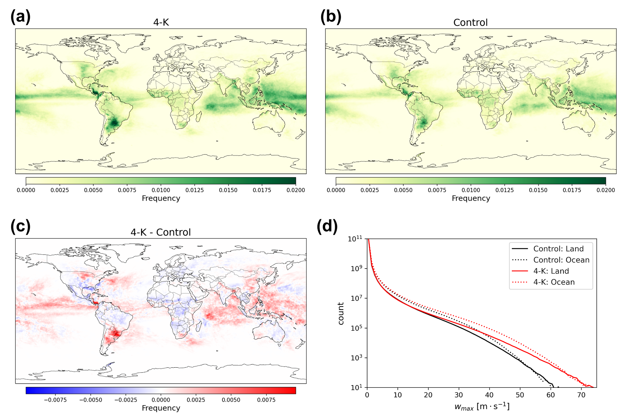
Warmed-climate X-SHiELD
Unprecedented years-long GSRM run in warmed climates
Continental convection shifts to higher latitudes: explicable by large-scale circulation shifts but not by CAPE changes
Additional simulations explore the effect on convection, precipitation, and clouds with
NSF PIRE-Cirrus project
Change in frequency of
intense convection with +4K SSTs
Cheng et al, GRL, 2022
Notes:
This is only one year and thus has limitations.

Slide 31
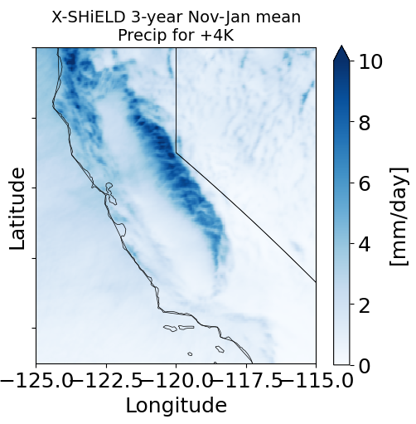
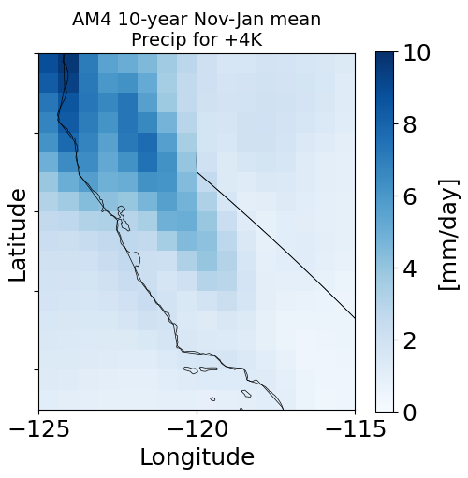
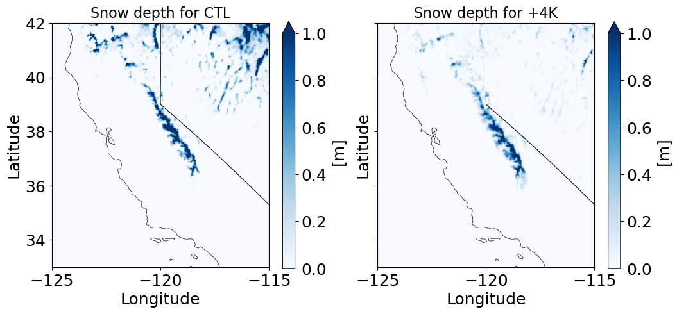
X-SHiELD and
Western Snowpack
Western US Hydroclimate-funded project
Higher resolution greatly improves orographic precipitation
(“Resolution is paramount”)
X-SHiELD suggests California might hold onto its snowpack
Courtesy Tsung-Lin Hsieh

Slide 32
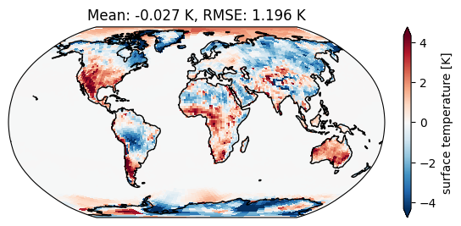



AI2 FV3net: ML-corrected Climate Modeling
The Allen Institute for AI has developed a hybrid dynamical-ML model
200-km FV3GFS with corrective tendencies trained on nudging tendencies to 3-km X-SHiELD outputs
ML-corrected annual runs show much improved land precipitation, diurnal cycle, and surface temperature 10000x less expensive than X-SHiELD!!
ML-corrected
Uncorrected Baseline
Kwa et al., JAMES, in review
Courtesy Chris Bretherton

Slide 33


To Infinity and Beyond:
Towards sub-k scale
Multi-nesting allows for O(1 km) simulation for hyper-local impacts
Applications of sub-km simplified FV3 to RCE, Prein “Giga-LES”, and process studies
Multi-center collaboration on SGS turbulence schemes (JTTI-funded) for LES simulations
Cloud properties in RCE: Jeevanjee and Zhou 2022, JAMES
Tele-SHiELD 1.4 km multi-nest
Courtesy Jan-Huey Chen
Mouallem
et al. 2022, GMD

Slide 34

In Conclusion
FV3 Global-nesting offers a world of possibilities
Storm scale & k-scale climate modeling has arrived
There’s plenty of room
at the (sub-km) bottom
Year-over-year improvements add up
Notes:
Summary slide

Slide 35
Challenges to the Community
What can we do with the NOAA’s massive free data resources?
  ex: Science of medium-range variability and predictability
Think holistically for both model development and analyses
  ex: Upscale impacts of explicit convection in GSRMs and global-nest
Keep raising standards and trying to beat them
  a.k.a. “Drift to high performance”
Let’s have a great time!

Slide 36

www.gfdl.noaa.gov/fv3
www.gfdl.noaa.gov/shield
“There are no shortcuts around quality, and quality starts with people.” — Steve Jobs
Thanks to GFDL Modeling Systems and
collaborators at EMC, AOML, NSSL, GSL,
Princeton CIMES, and the Allen Institute for AI

