Slide 1

Building a Community Verification and Diagnostics Framework for the UFS
Tara Jensen
NCAR/RAL and DTC
UFS Webinar Series
9 March 2023

Slide 2
METplus Team and Core Collaborators
Management:
  Tara Jensen¹, Molly Smith², Bonny Strong², Dave Turner²
MET Engineering:
  John Halley Gotway¹, Howard Soh¹, Randy Bullock¹, Seth Linden¹, Dave Albo¹
METplus Engineering:
  George McCabe¹, Julie Prestopnik¹
METplus Analysis Suite Engineering:
METviewer, METexpress, METdataio, METcalcpy, METplotpy
  Venita Hagerty², Tatiana Burek¹, Minna Win-Gildenmeister¹, Hank Fisher^{1,} Molly Smith², Randy Pierce²
Atmospheric Science:
  John Opatz¹, Dan Adriaansen¹, Tina Kalb¹, Jonathan Vigh¹, Jason English², Jeff Hamilton², Mrinal Biswas^{1,} Tara Jensen¹
Statistics:
  Eric Gilleland¹, Barb Brown¹
NCAR/RAL and DTC 2. NOAA/GSL and DTC
EMC
  Jason Levit, Geoff Manikin, Alicia Bently, Logan Dawson, Mallory Row, Perry Shafran, and the rest of VPPPG Branch
Met Office
Air Force
Naval Research Lab
Community
  UFS Verification and Validation Cross Cutting Team
  Other NCEP Centers: WPC, CPC, SWPC, SPC, OPC, NCO
  NOAA Labs: GSL, PSL, MDL, ARL
  NCAR and UCAR: RAL, MMM, CGD, ACOM, COMET
  Universities and Cooperative Institutes: UW CIMMS, CSU CIRA, CU CIRES, George Mason University, SUNY Albany, SUNY Stony Brook, Embry Riddle U, University of Illinois Urbana Champagne, University of Miami
  For Profits: AER, SPIRE

Slide 3
METplus History
Goals
Develop a verification package that can be used across the community
Replicate core capability of EMC VSDB package. This was completed in 2015
2023 – All components
accepted for install on WCOSS2
2019 – METplus Analysis Tools dev started
2021 – METplus wrappers accepted for install on WCOSS
2016 – METplus Wrappers dev started
2017 – EMC starts developing Global workflow using METplus on WCOSS
2009 - METviewer dev started
2015 - Selected as verification package for UFS
2004 – MET idea formed
2008 - First Release
of MET
Current METplus Code Base
C++
Fortran
Python – limited libraries

Slide 4
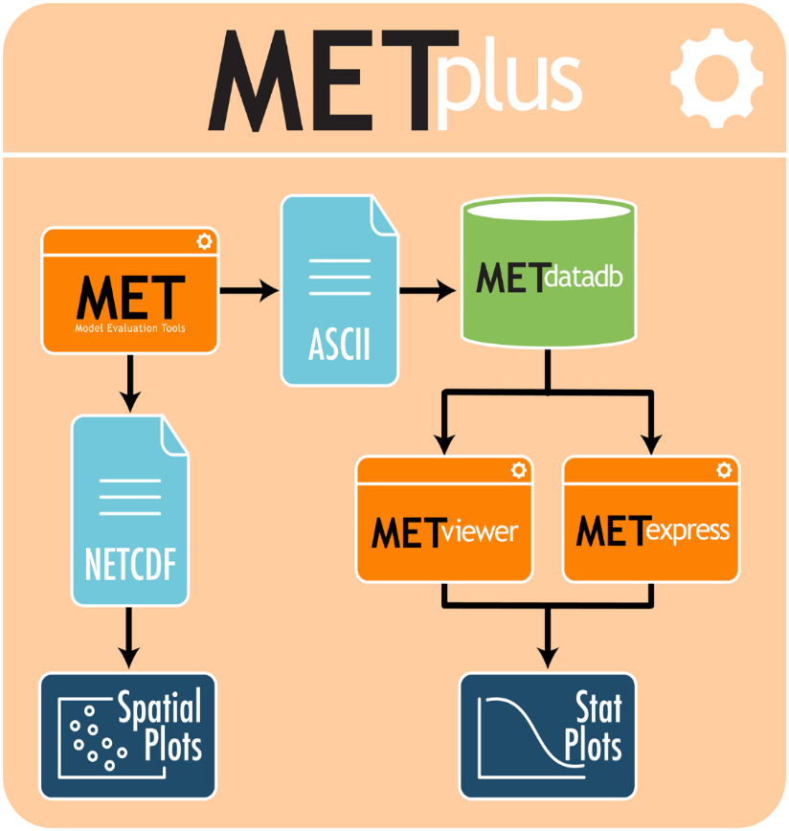
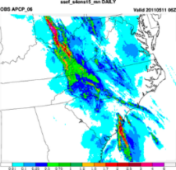
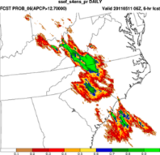
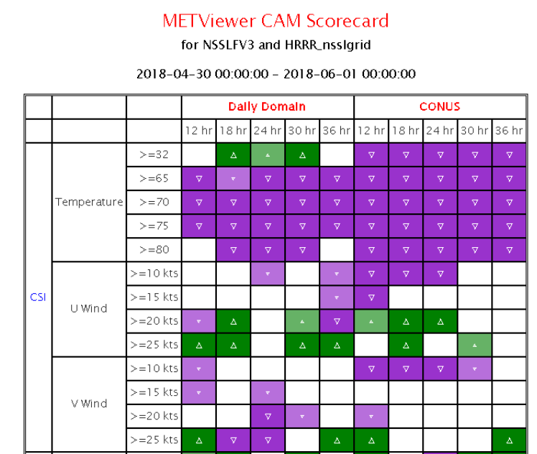
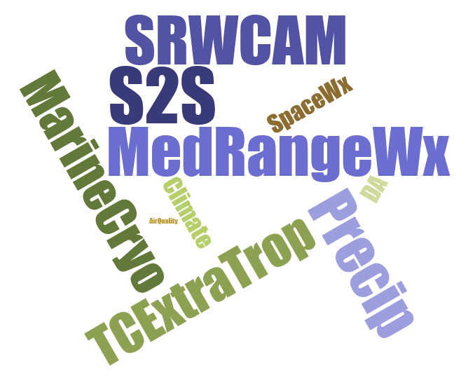
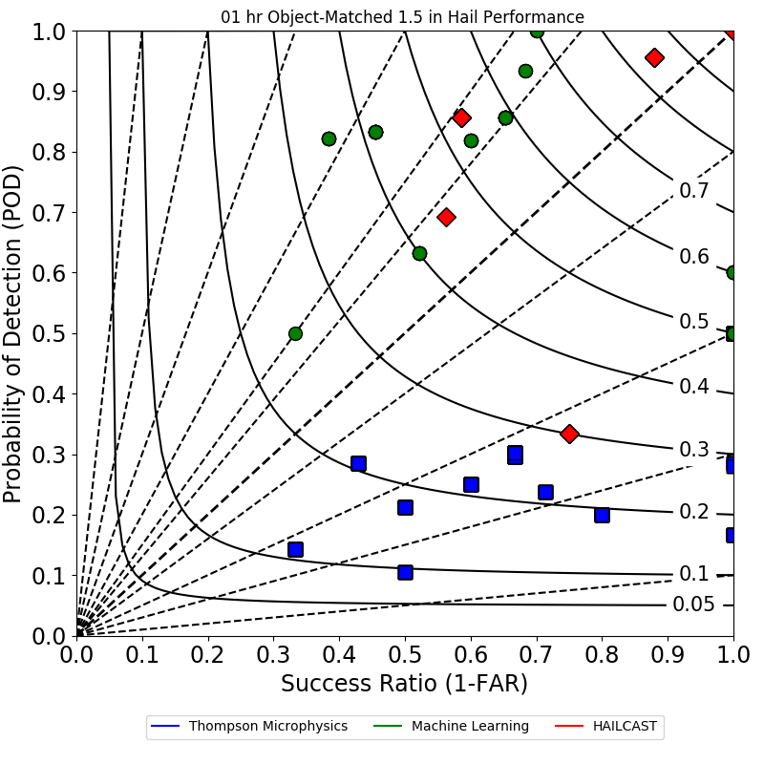
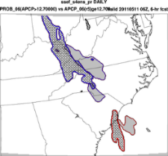
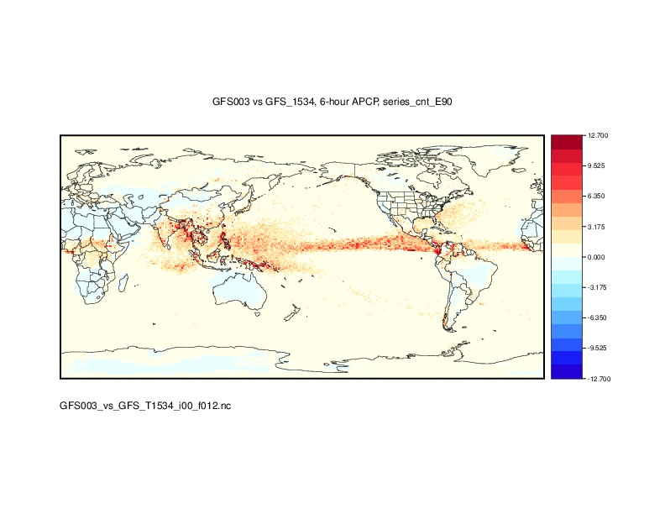
The Result: METplus Framework
Suite of Python wrappers around
MET (core)
Analysis Tools
  METviewer/METexpress User Interface
  METviewer Batch Engine
  Python-based Diagnostics and Plotting
Communication between MET & python algorithms
Using manage_externals to connect repos
Over 150 traditional statistics and diagnostic methods for both point and gridded datasets
15 interpolation methods
Applied to many spatial and temporal scales
Developed to allow for easy sharing of config files for reproducible results
3500+ users; US and Int’l
Analysis Tools
METplus Examples/Use-Case In Development
Bad forecast or
Good forecast
with displacement
error?
Notes:
SRW – Short Range Weather
CAM – Convection Allowing Model
MRW – Medium Range Weather
S2S – Subseasonal to Seasonal

Slide 5



Repository and Workflow
Recent Changes
Adopt GitHub Issues to define new features, enhancements, and bugfixes (v10.0.0)
Adopt GitHub Projects to track progress toward releases (v10.0.0)
Adopt Pull Requests to facilitate code review and approval (v10.0.0)
Switch to semantic versioning, X.Y.Z for major, minor, and bugfix versions (v10.0.0)
Switch documentation to reStructuredText with Read the Docs (v10.0.0)
Automate Continuous Integration (CI) testing via GitHub Actions and Docker (v10.1.0)
Added Beta Releases for more robust user testing (v10.0.0)
Restructure repository so it can be compiled directly (v11.0.0)
Release code directly from GitHub (v11.0.0)
Create METbaseimage repository for Docker compilation (v11.0.0)
Using Sonarqube for cybersecurity
Notes:
And that brings me to the first set of changes I’d like to talk about… changes to the MET repository and workflow.
The move to remote work prompted huge changes, and for our team, that basically meant adopting all things GitHub.
<CLICK>
We created GitHub issue templates to lay out our workflow for adding new features, enhancing existing functionality, and fixing bugs. We started using Pull Requests to facilitate code reviews. And GitHub projects provided us with a way to organize our work into development cycles and track our progress toward releases.
<CLICK>
Switching from LaTeX based documentation to reStructureText with Read the Docs was a huge step forward. Read the Docs makes it very easy for developers to add or update documentation while working on code changes. And those changes are automatically rendered and included in Pull Reviews.
<CLICK>
In version 10.1.0, we put a lot of effort into automating our continuous integration testing using GitHub actions. A full regression test is automatically run for each Pull Request, making the approval process much more efficient.
<CLICK>
For the recent 11.0.0 release, we restructured the repository and software release process. The repository now matches the structure of the release tarfile so that users have the option to compile the cloned repository directly.
Each of these workflow changes was coordinated across the development teams for each METplus component. I’d like to emphasize the importance of the automated continuous integration testing. It has really saved our team a lot of time and money by preventing bugs from making it into the released code.

Slide 6
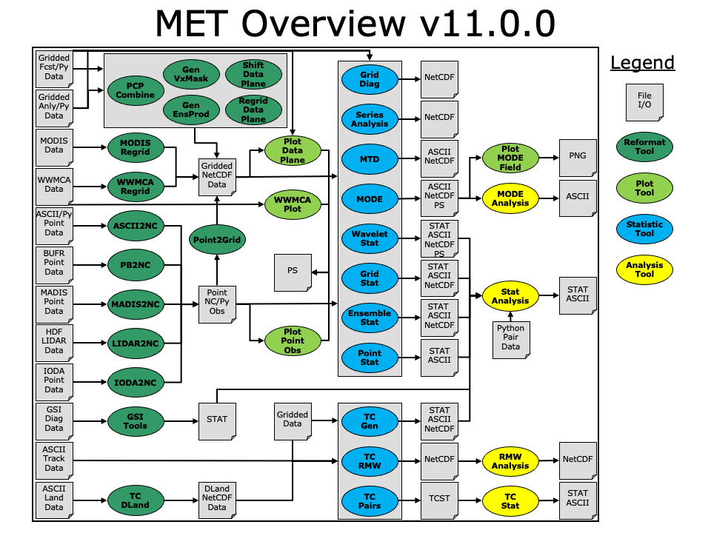
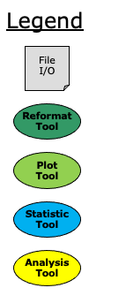


Tools for Standard Statistics
Includes tools for:
Reformatting
Quick look plotting
Statistics computation
Analysis

Slide 7


Tools for Diagnostics
Includes tools for:
Reformatting
Quick look plotting
Statistics computation
Analysis

Slide 8




Tools for Preprocessing
Includes tools for:
Reformatting
Quick look plotting
Statistics computation
Analysis
PythonEmbedding

Slide 9
What is Python Embedding?
Allows for ingest of data formats not currently supported directly by MET
Observations: If you can write a Python script to read an observation format and put it into a PANDAS array METplus should be able to use it
Analyses and Forecasts: If on a standard atmospheric modeling projection and you can write a Python script to read it and put it into a NUMPY, or XARRAY format, METplus should be able to use it
With Python Embedding
Python
Script
Point NetCDF Obs
Without Python Embedding
ASCII2NC
ASCII Point Data
Point NetCDF Obs
ASCII2NC
ASCII Point Data
HDF, netCDF, ASCII, CSV, other?

Slide 10
What’s New and Improved

Slide 11
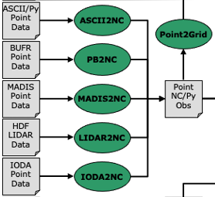
Point Pre-Processing Tools
IODA2NC ingests Interface for Observation Data Access (IODA) data from JEDI (v10.0.0)
  Update to read IODA version 2 data (v11.0.0)
MADIS2NC supports updated input format (v10.0.0)
PB2NC derives PBL and CAPE (v10.1.0)
Define common API for reading/writing NetCDF point observation files (v10.1.0)
ASCII2NC reads NDBC buoy data, EPA AirNow data, and AERONET v3 (v11.0.0)
"-format ASCII_format" may be set to "met_point",
"little_r", "surfrad", "wwsis", "airnowdaily_v2",
"airnowhourlyaqobs", "airnowhourly",
"ndbc_standard", "aeronet", "aeronetv2",
"aeronetv3", "python".
Notes:
Next, I’d like to talk about enhancements to the point pre-processing tools in MET.
<CLICK>
These tools are found in this section of the flowchart. They are run to prepare point observations from a variety of different sources for use by the MET statistics tools.
The ioda2nc tool was added in version 10. It ingests data formatted following the Interface for Observation Data Access – or IODA format – for the JEDI data assimilation system. And version 11 of MET was enhanced to support version 2 of that format. This represents an initial interoperability between MET and JEDI, there’s a lot of potential for closer integration.
Similarly, the madis2nc tool was enhanced in version 10 to handle the updated input data formats.
The PB2NC tool which ingests observations in the BUFR and PrepBUFR formats was updated in version 10.1 to derive additional observation types, such as PBL height and CAPE. We worked with closely NOAA/EMC staff to incorporate their existing Fortran derivation routines into MET.
In version 10.1, Howard Soh, one of our developers, overhauled the internal API we use for reading and writing these NetCDF point observation files. That made it much easier to extend common functionality across all of these tools, such as the computation of time summaries at individual stations.
<CLICK>
And lastly, the ASCII2NC tool, which ingest point observations in a variety of ascii formats, was enhanced in version 11 to support NDBC buoy data, EPA AirNow data, and Aeronet version 3 data.

Slide 12
Point-Stat, Grid-Stat, Stat-Analysis
New line types
  SEEPS and SEEPS_MPR line types added (v11.0.0)
  Skill Score Index (SSIDX) line type added to Stat-Analysis (v10.1.0)
New statistics
  Continuous: Uncentered Anomaly Correlation (v9.1) and Scatter Index (v10.1.0 )
  Categorical: HSS Expected Correct (v10.1.0)
  Probabilistic: RPS complement (v9.1.0)
  Distance Map: G and GBETA (v10.1.0)
New options
  Conditional: Specify MPR column and threshold to filter pairs (v10.0.0)
  Stat-Analysis job handles multiple output thresholds and line types (v10.0.0)
  Open-MP in Grid-Stat for computing neighborhood statistics (v10.1.0)
Notes:
The Point-Stat and Grid-Stat tools implement largely traditional verification methods by comparing gridded numerical weather prediction data to point observations or gridded analyses. And that Stat-Analysis tool reads their output and aggregates results across multiple runs.
During these 4 versions, we enhanced these tools in several ways.
<CLICK>
As of version 11, Point-Stat and Grid-Stat both compute SEEPS when verifying precipitation forecasts. SEEPS stands for Stable Equitable Error in Probability Space and is a standard WMO statistic.
Add the skill score index line type was added to Stat-Analysis. That enables the summary GO Index and CBS Index values computed for the US Air Force to be loaded into and plotted by METviewer.
<CLICK>
Several new statistics were added to existing line types, and you can see them listed here.
<CLICK>
And we also added new configuration or runtime options. For example, the MPR column and threshold options enable conditional verification, where you can select matched pairs that meet some thresholds criteria. You could see how the bulk statistics compare when the fcst – obs differences are relatively small or very large.
A UK MetOffice engineer contributed changes to Grid-Stat to parallelize the computation of neighborhood statistics in version 10.1. And there’s lots of potential to speed up other areas of the code as well.
Each of these changes is the result of our team collaborating with another group, often a NOAA lab, the Naval Research Labs, the Air Force, the UK MetOffice, or other groups within NCAR. As we expand the use of MET to new areas, we identify shortfalls and enhance the software as we go.

Slide 13
Ensemble Verification
Ensemble
Stat
Gen
EnsProd
Ensemble
Stat
Add Gen-Ens-Prod for ensemble post-processing (v10.1.0) and remove it from Ensemble-Stat (v11.0.0)
Continuous Ensemble Statistics: Hersbach CRPS (v10.0.0), Fair CRPS, MAE, Spread Absolute Difference, Bias Ratio (v11.0.0)
Support all input ensemble members in the same file (v10.1.0)
Standardize ensemble members relative to climatology (v10.1.0)
Apply HiRA methodology to ensembles (v10.1.0)
Ensemble-Stat derives probabilities on the fly and verifies them directly (v10.1.0)
Define ensemble control member on the command line (v11.0.0)
"-ctrl file" specifies the gridded ensemble control data file included in the mean but excluded from the spread
Notes:
Ensemble verification saw large changes as well.
The largest of these is splitting the Ensemble-Stat tool out into 2 different tools. Ensemble post-processing, such as generating probability forecasts, moved from Ensemble-Stat to the new Gen-Ens-Prod tool. The configuration file for Ensemble-Stat had gotten way too complex and so we decided to split apart these tools to reduce that complexity.
<CLICK>
Through feedback from the MetOffice and NOAA, we added several new continuous measures of ensemble performance listed here.
<CLICK>
And we added several new runtime options as well.
Sometimes all ensemble members are stored in the same input file rather than one for each. So we adjusted the software to handle that. Another option enables the ensemble member to be standardized relative to climatology data. We applied the High Resolution Assessment methodology to ensemble data for the MetOffice. And for NOAA/EMC we enhanced Ensemble-Stat to derive simple probabilities on the fly and verifying them directly in a single run. That simplified their workflow. And lastly, we enabled the specification of a ensemble control member. That’s included in the computation of the ensemble mean but not the spread. Interestingly, we’ve found that control members are not often used in the US but are used in the UK.

Slide 14
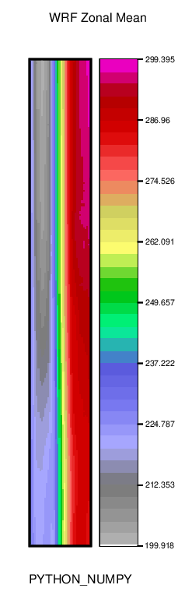
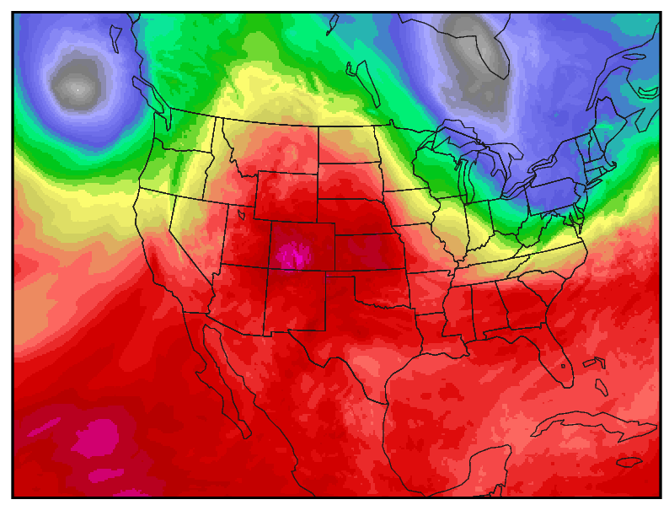
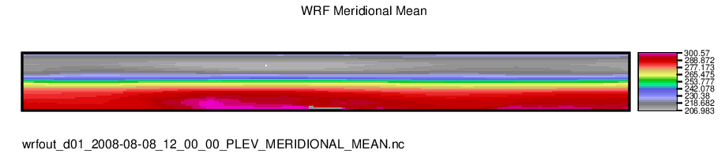
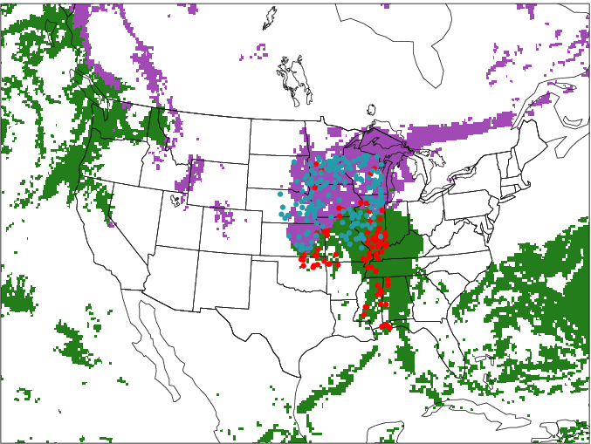
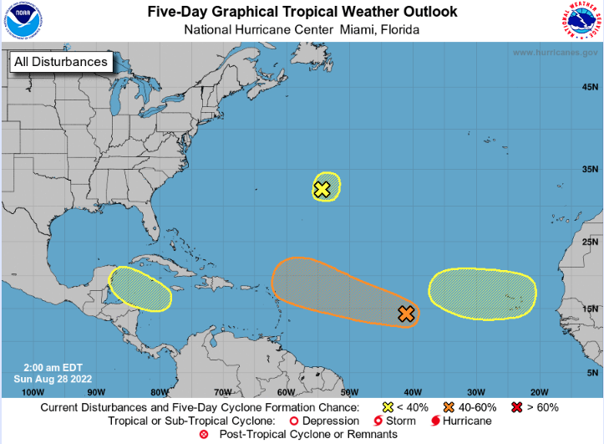
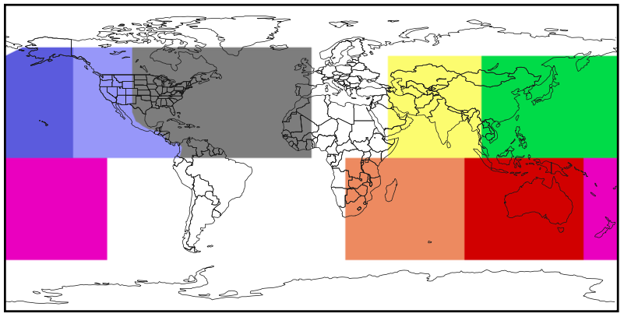
Additional Enhancements
Add support for semi-structured grids via Python embedding
TC-enhancements
  Filter genesis spatially with a pre-defined global TC Basin and RMSC definition
  Verify E-Deck genesis probabilities and NHC tropical weather outlook shapefiles
Enhanced support for Point-Obs
  Direct ingest of obs through Python Embedding into Point-based tools
  Quick-look tool that plots point obs and gridded forecast field
Notes:
Several new config file options apply to many tools. And I’ll highlight a few of them here.
In version 9.1, we added several options for overriding metadata read from input files. Those options are shown here.
<CLICK>
Versions 10 and 11 added support for more NetCDF data types and allowe
d the specification of dimension values rather than integer indices.
These version also added support for rotated lat/lon grids and semi-structured grids.
And we also updated the map data provided with MET in version 11.
Let me show an example to demonstrate some of these changes.
<CLICK>
Here I’ve run the plot_data_plane tool to plot 500mb temperature data. While the NetCDF variable is named “TT”, note that I used the set_attr_name option to rename it as Temperature. Similarly, I’ve specified the level string as ”500MB”. In earlier versions of MET, I would have had to specify the integer index for each dimension. As of version 11, I can use the @ symbol followed by the desired value for that dimension. And MET finds and uses the matching dimension index.
<CLICK>
Lastly, I can run a custom python script to read this gridded data and compute a zonal or meridional means of the data over multiple pressure levels. And we’ve called these semi-structured grids. They could also be used for Hovmoeller plots. This data can be passed to Grid-Stat and it can compute statistics on the result.

Slide 15
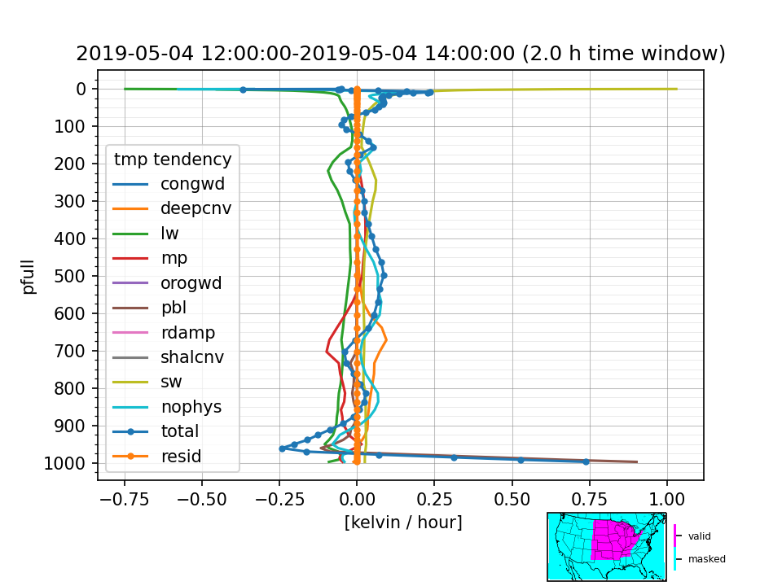
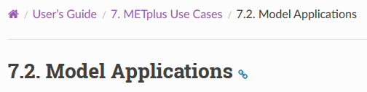
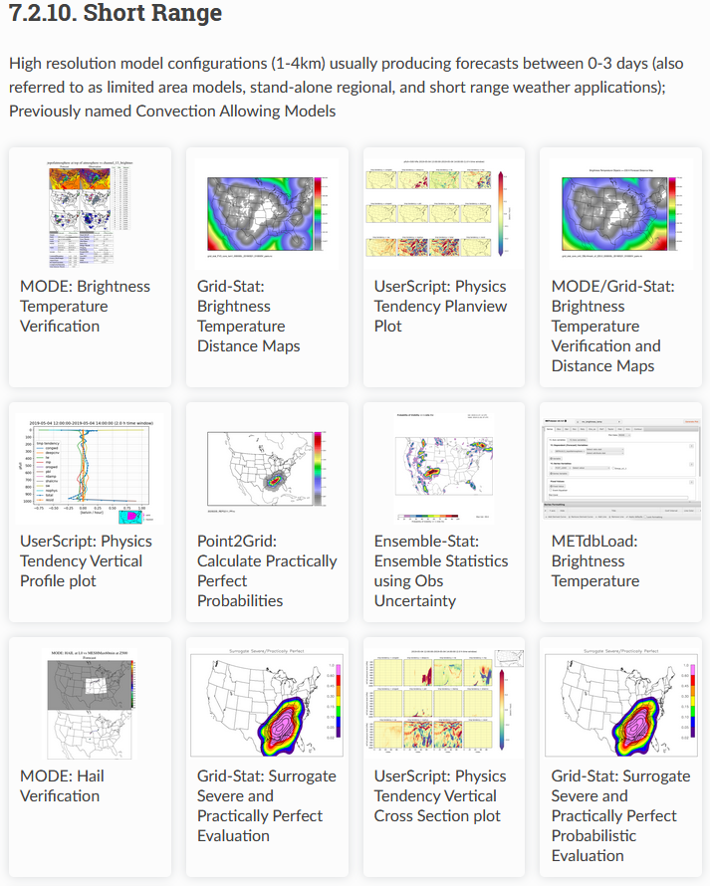
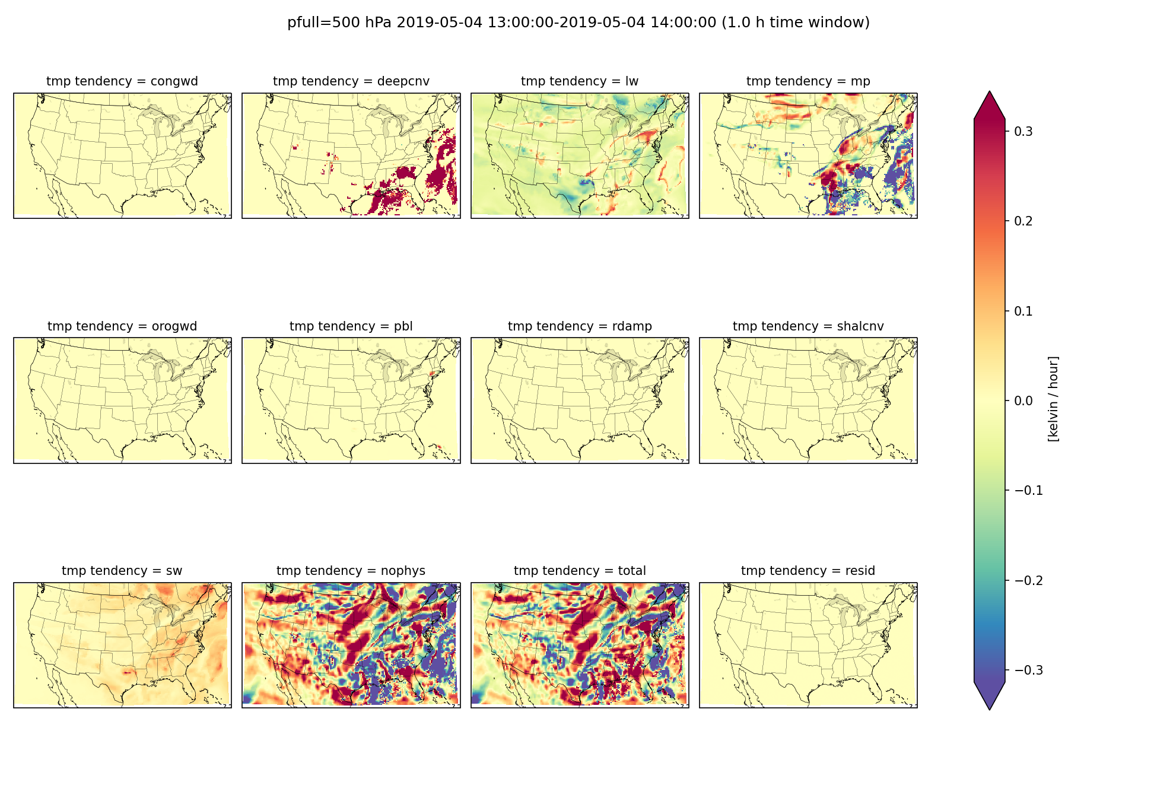
Physics Tendencies
Contributed by Dave Ahijevych, NCAR/MMM through JTTI project

Slide 16
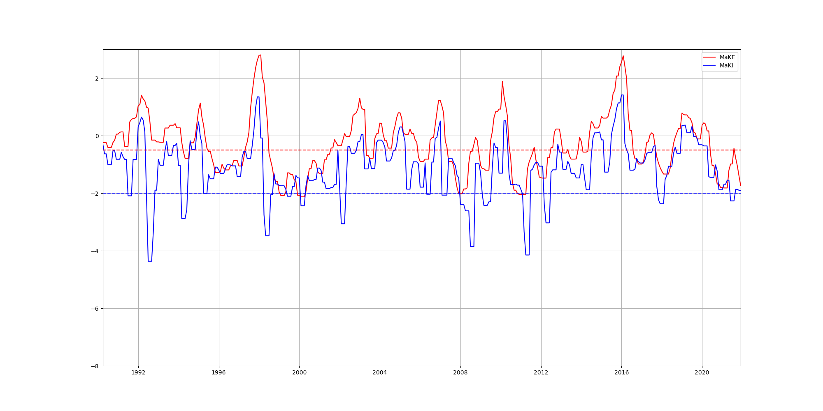
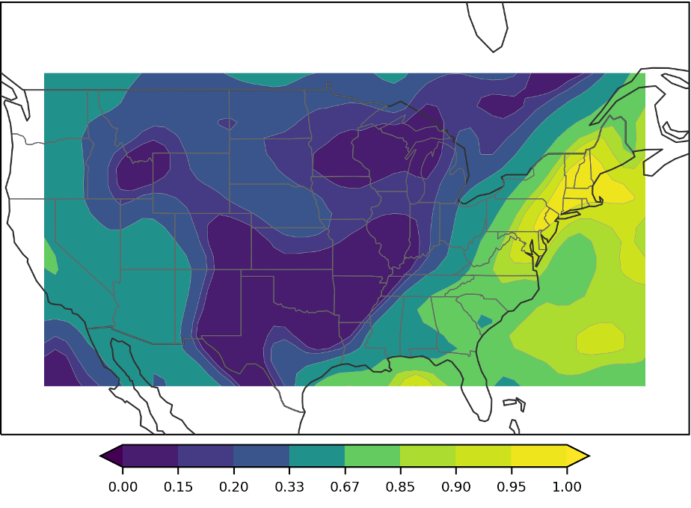
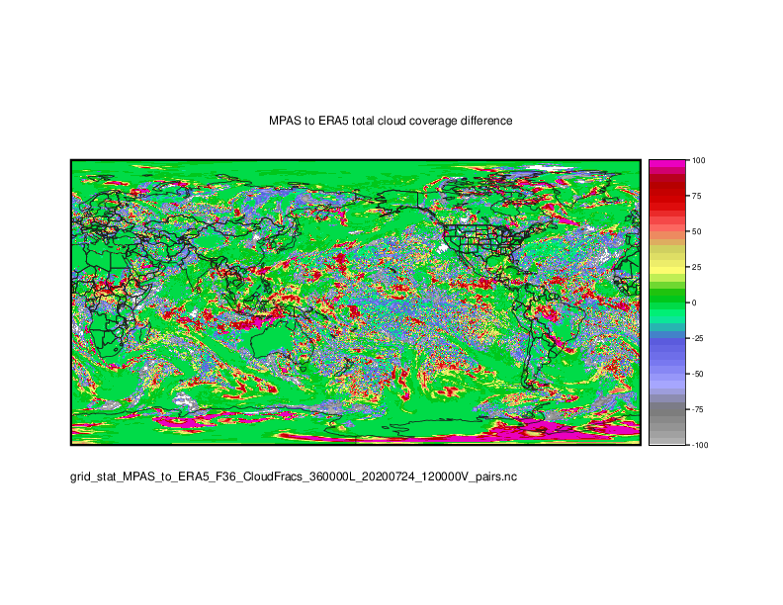
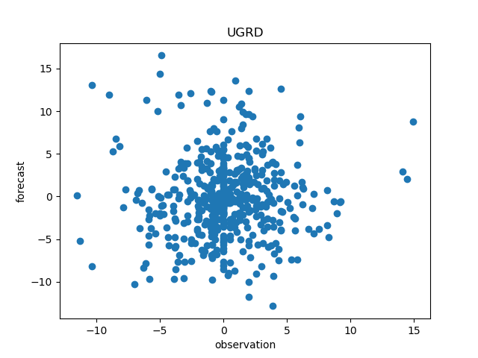
Additional METplus Use Cases
MJO-ENSO diagnostics
Probability of Exceedence for given percent
Cloud cover use cases for MPAS and GFS ile
Statistics computation using IODA v2.0 format
Statistics computation for native unstructured LFRic grid

Slide 17
Examples from the Community
Borrowed from Presentations at 2022 DTC METplus Users’ Workshop
https://dtcenter.org/events/2022/2022-dtc-metplus-workshop

Slide 18
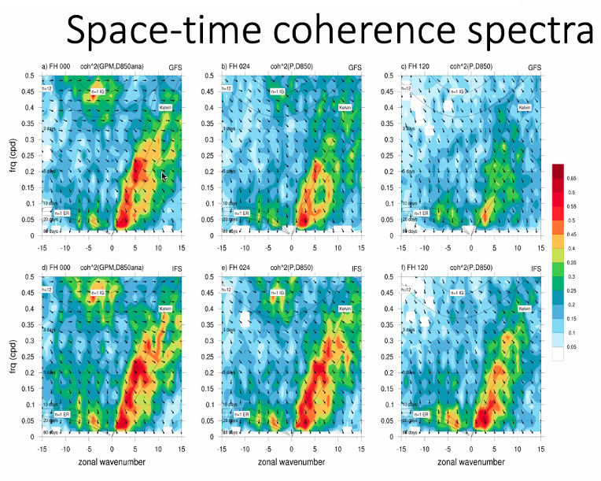
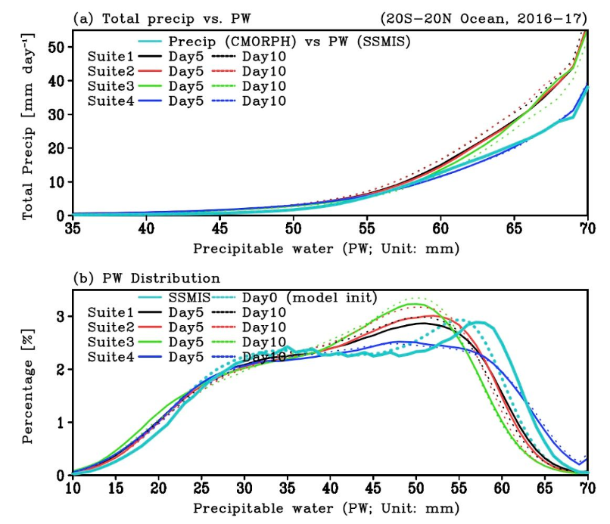
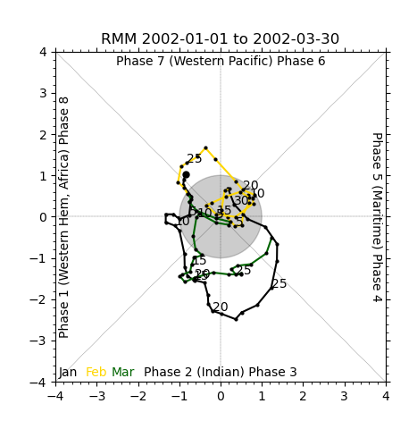
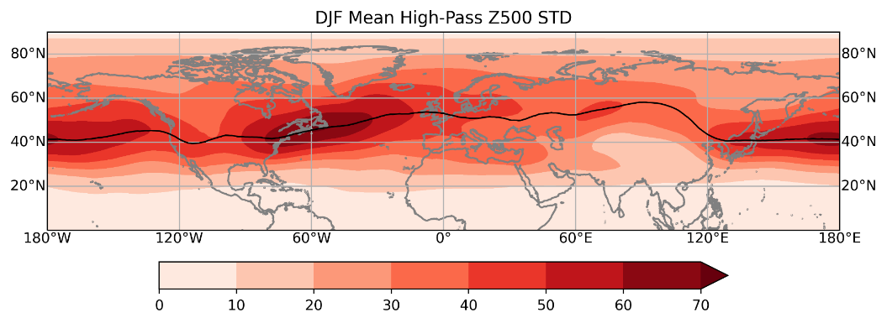
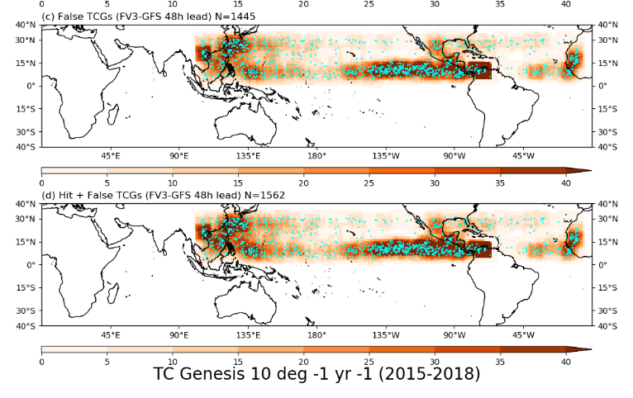
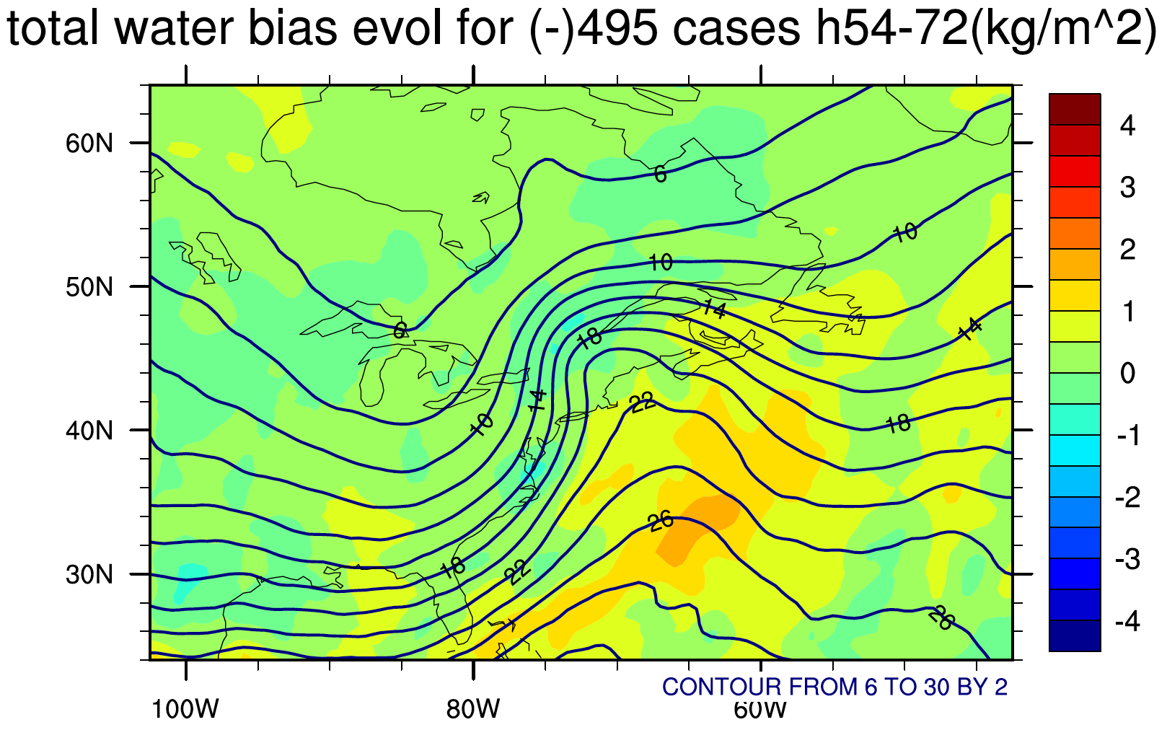
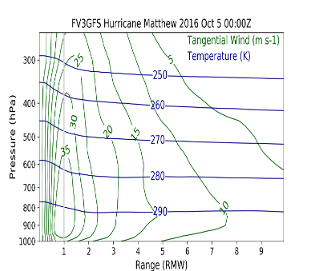
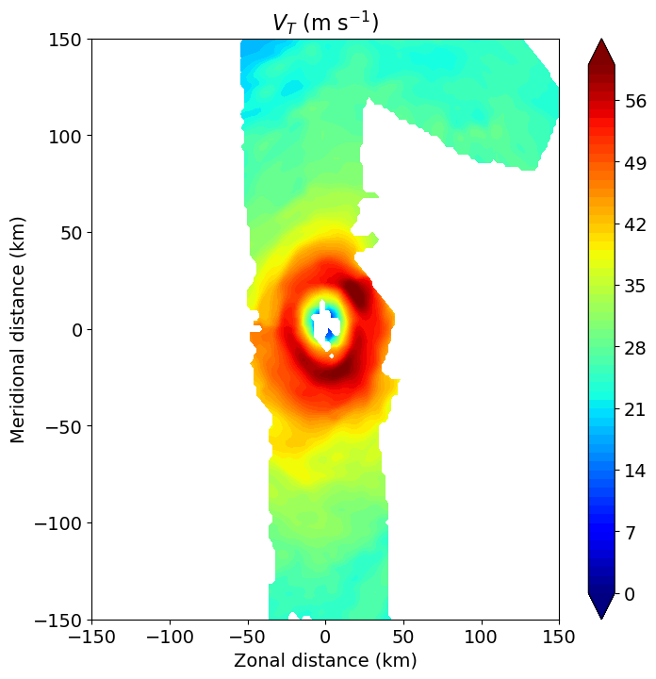
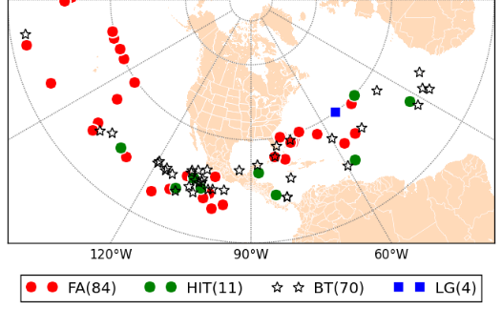
Examples of Community Contributions
S2S Multivariate Distributions
S2S Diagnostics
Systematic Errors
TCs New Projections and Obs
S2S TC-Genesis

Slide 19
Examples of Community Contributions
S2S Multivariate Distributions
UIUC: Fortran Rewritten to C++ and generalized
NOAA PSL: Python
Integrated into METplus codebase through generalization and refactoring
S2S Diagnostics
UIUC: Matlab Converted to Python and generalized
Systematic Errors
TCs New Projections and Obs
NCAR MMM: Python
Integrated into METplus codebase
S2S TC-Genesis
SUNY Stony Brook: Procedure
Coded in C++, wrap in Python, and generalized
CIRA: Fortran and Python Rewritten in C++ and generalized
NOAA HRD: Python
Integrated as Python Embedding
ERU: Algorithm Coded in C++ and generalized

Slide 20
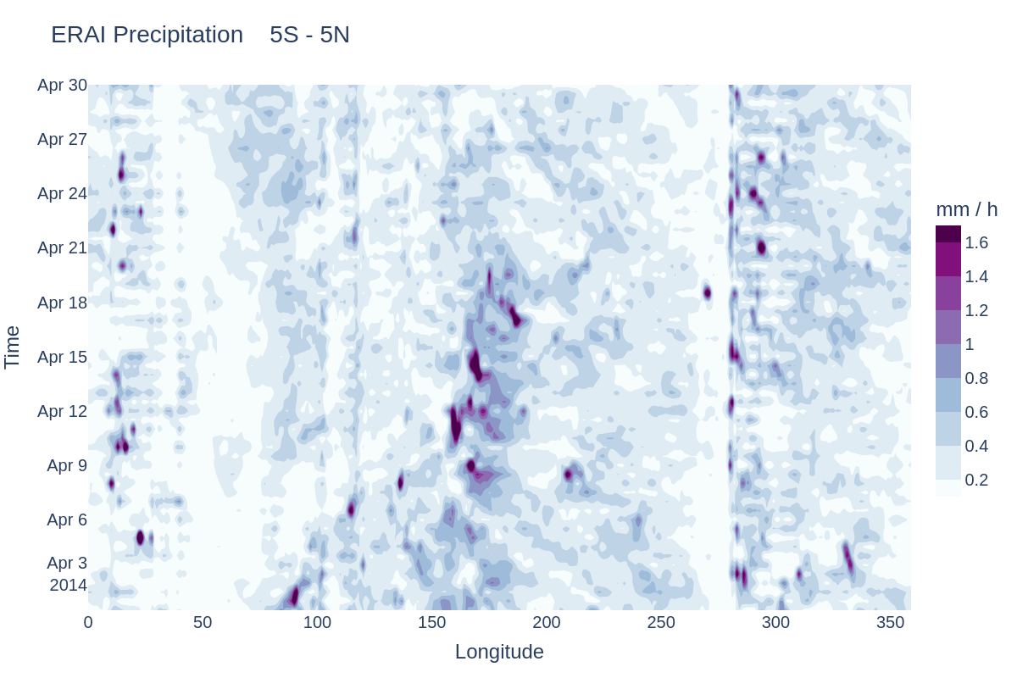
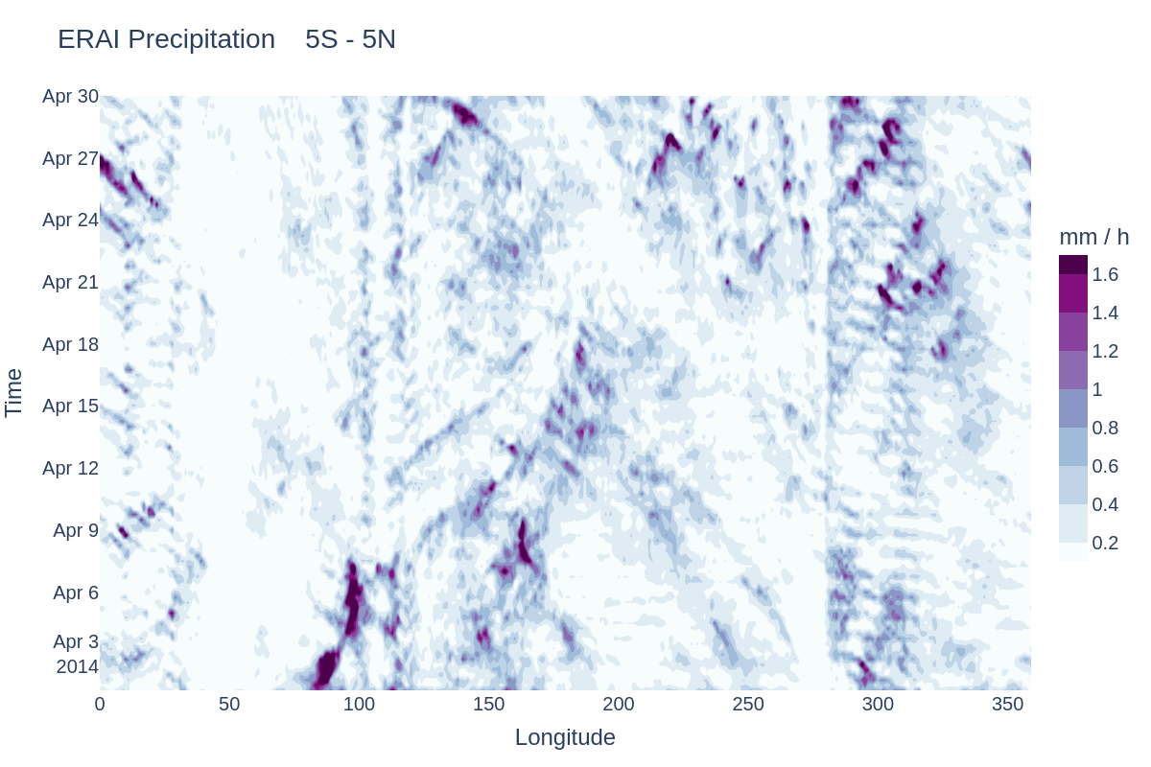
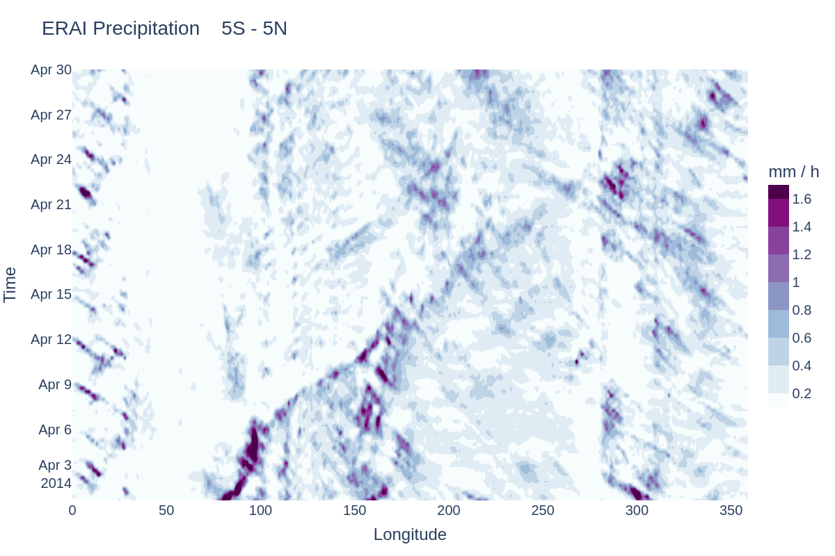
Hovmoeller Diagrams Applied to UFS Prototypes
UFS P5
UFS P7
Ran metplus 3 times with different input and yaml files.
Each run outputs one figure for the given input file.
At the moment the aspect ratio settings and title are not read by the python script.
Differences between verification, P5 and P7 are apparent.
Good agreement at the beginning of the forecast (April 1) with rapid decorrelation of forecast and verification.
P7 appears to have more light precipitation than P5 and less well-defined diurnal cycle over South America.
Slide Courtesy of Maria Gehne, NOAA/PSL

Slide 21
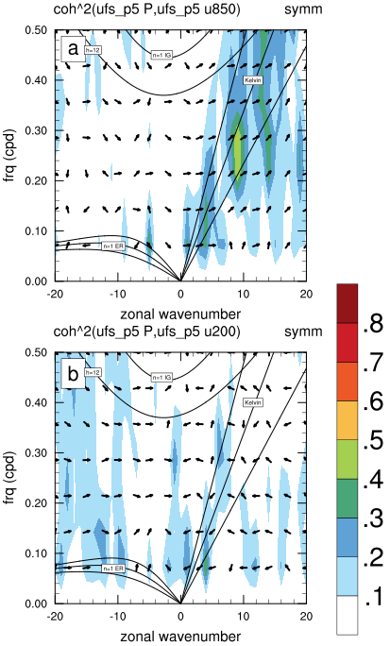
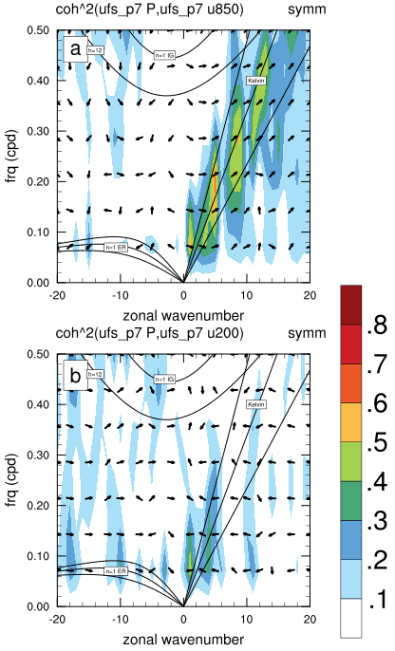
Space-time Coherence Spectra Applied to UFS Prototypes
Coherence-squared spectra show regions in wavenumber-frequency space where precipitation and zonal winds are coupled.
Shows that UFS P7 has stronger convection-dynamics coupling than UFS P5. And P7 is more consistent with observations.
Need to add more flexibility to these plotting tools.
Slide Courtesy of Maria Gehne, NOAA/PSL

Slide 22
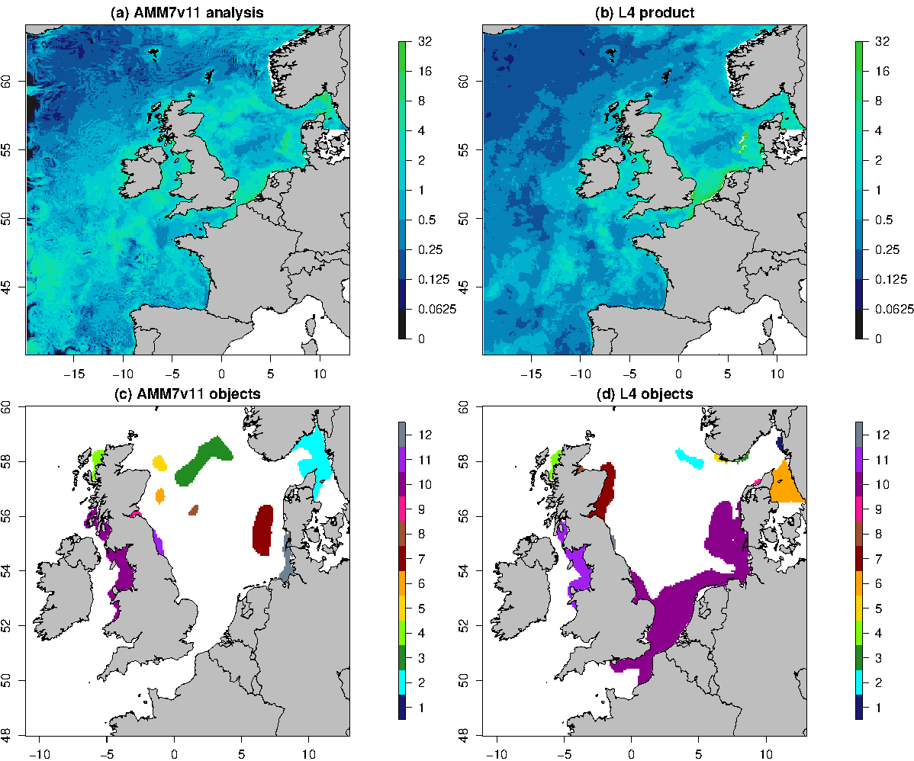
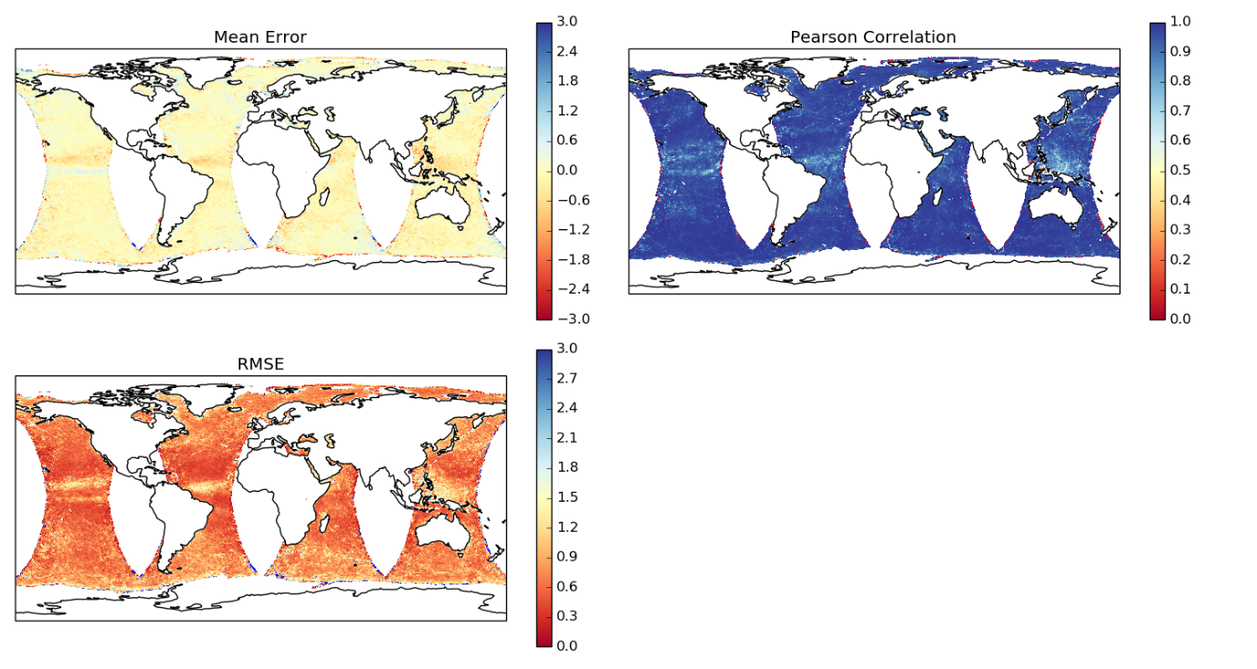
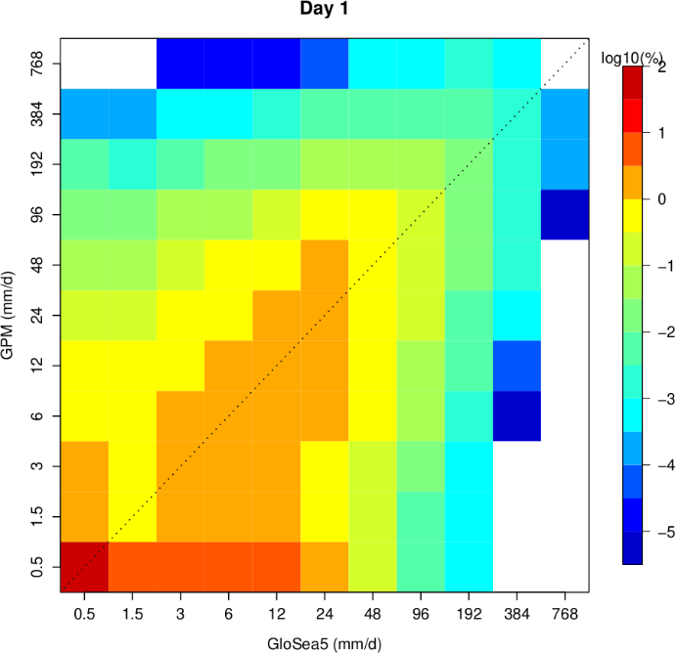
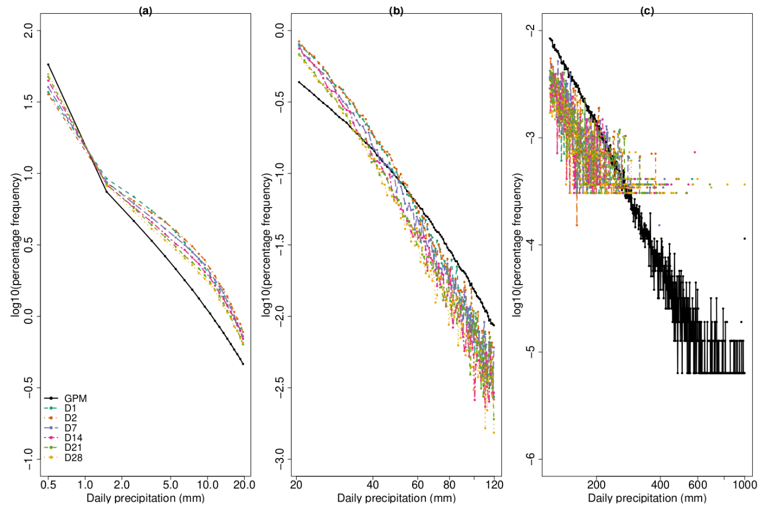
Series-Analysis output of scatterometer winds
MODE output for Chlorophyll-a
Ric Crocker
Mittermaier et al. 2021, Ocean Science
Slide Courtesy of Marion Mittermaier, Met Office
Joint and marginal distributions
Grid-Diag

Slide 23
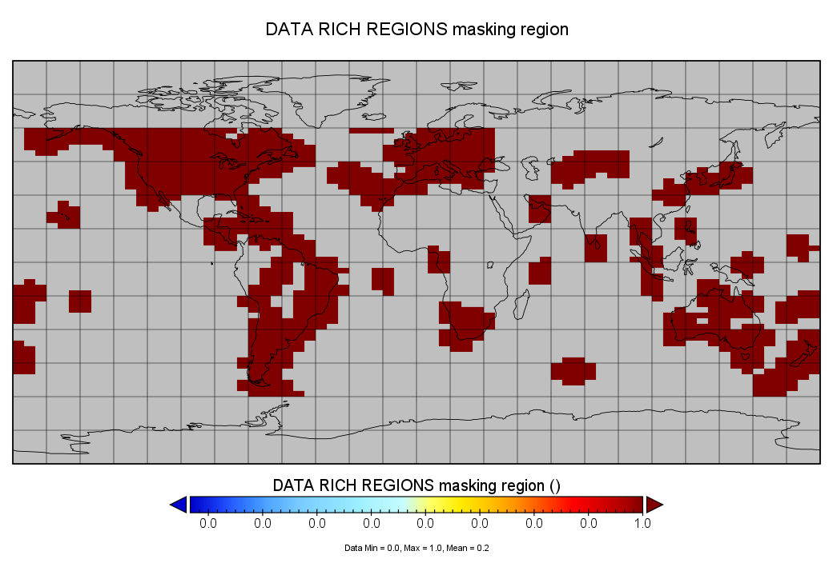
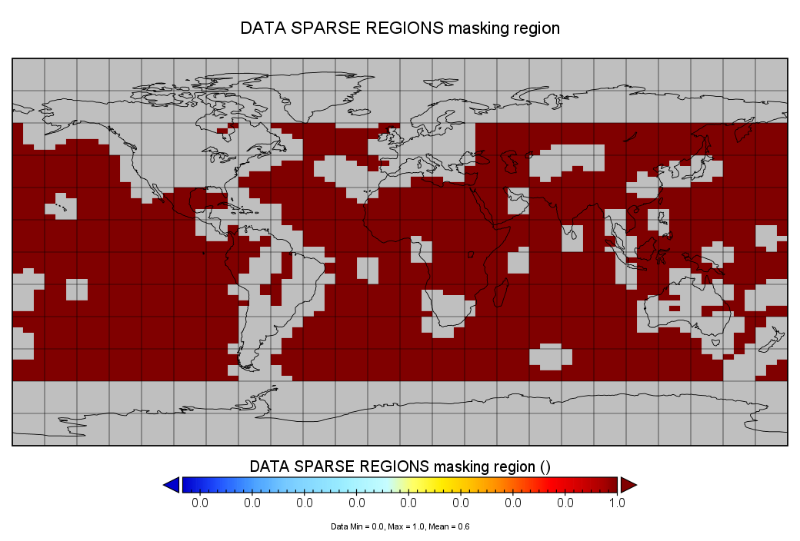
Example of Defining Verification Regions using Quality Control Flag for Space Weather
2. Data Rich vs. Data Sparse Regions
Near Observing Stations
Not Near Observing Stations

Slide 24
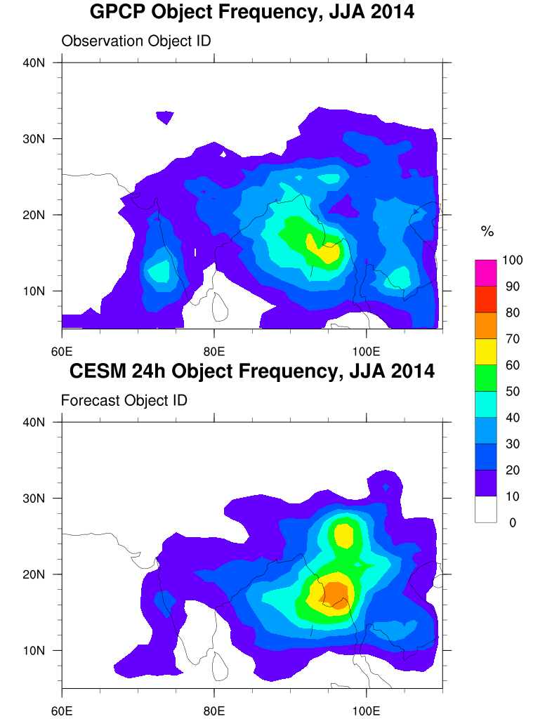
MODE Precipitation Object Frequency in Climate Models
JJA Frequency >=12 mm/day
CESM object Frequency bi-modal
  Southern area too frequent, too far North
Western India: CESM too few objects (not enough precipitation), too far North
Peak over Thailand/Cambodia region not well captured
Slide Courtesy of Tina Kalb, NCAR/RAL and DTC

Slide 25
METplus for Stages and Gates

Slide 26
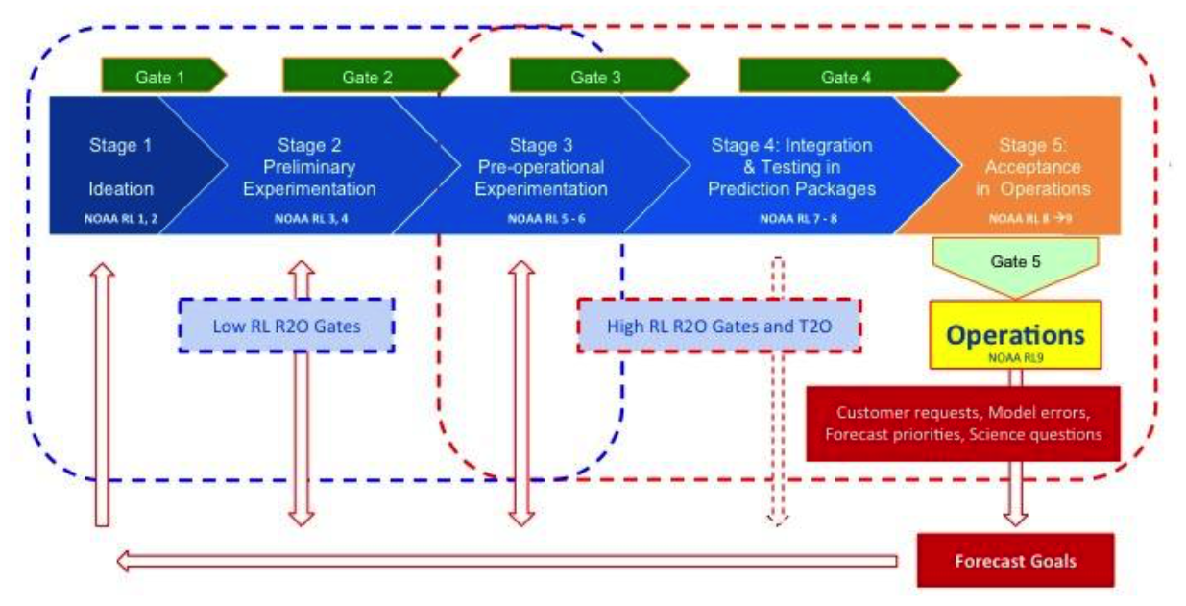
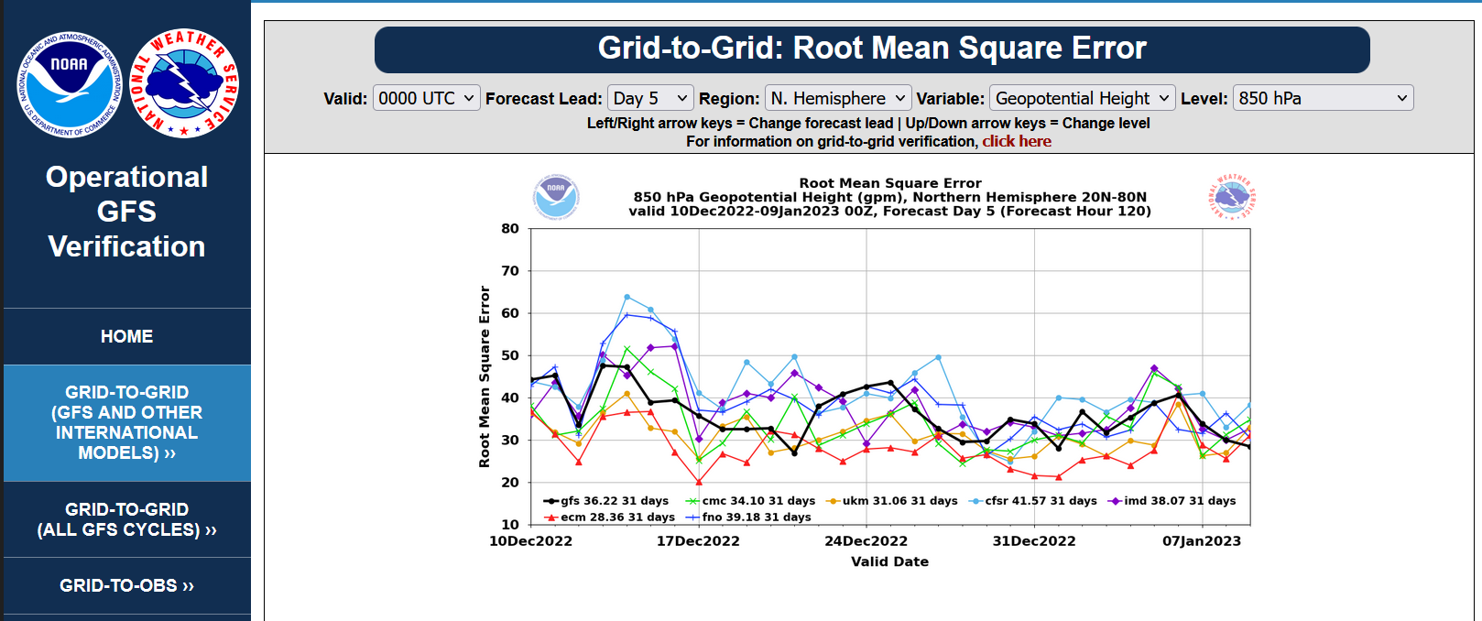
Stages and Gates
EMC Verification System (EVS)
Challenges:
Contributed S2S, Marine and Cryosphere, and Aerosol diagnostics sometimes use Python libraries not accepted by NOAA NCO – Need to remove dependencies on libraries
From Stages and Gates – Tolman, 2021

Slide 27
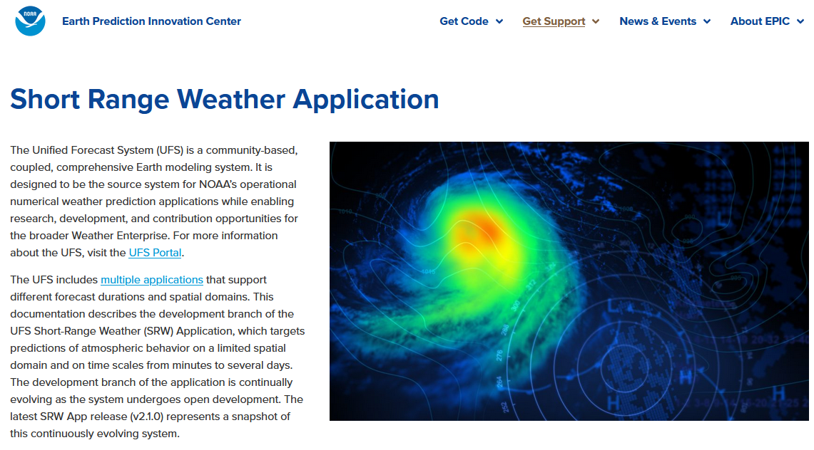
Stages and Gates
Challenges:
Developing a framework that can be used operationally and within a testing and evaluation workflow.
Key to success for METplus:
METplus Analysis Suite that uses the same libraries regardless of platform and data storage method (database vs. flat files)
METplus v5.0 includes command line capability to replicate much of what is produced by METviewer and METexpress
From Stages and Gates – Tolman, 2021
DTC Testing and Evaluation
Short Range Weather App Workflow
Medium Range Weather App Workflow
Hurricane App Workflow
Space Weather App Workflow

Slide 28
Stages and Gates
Challenges:
Providing diagnostic tools that can be used within a Hierarchical System Development (e.g. case studies, single column model, aqua planet run, limited area runs, etc…) in concert with bulk statistics
Recently Added:
METplus v5.0 includes model tendency diagnostics and incremental progress towards evaluation of native and unstructured grids
METplus has many diagnostics for these gates and still adding more
From Stages and Gates – Tolman, 2021
Model Tendency diagnostics
contributed by NCAR/MMM

Slide 29
Support and Training

Slide 30
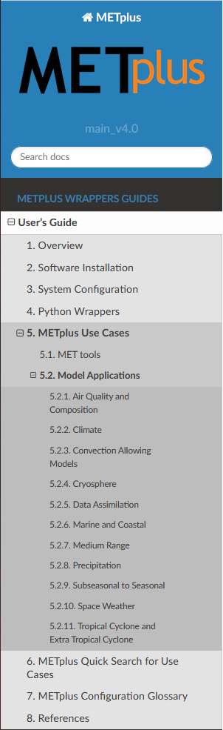


User’s Guide and
Getting Help
https://github.com/dtcenter/METplus/discussions
https://metplus.readthedocs.io/en/
latest/Users_Guide/

Slide 31


METplus Training Series
Advanced (2023)
https://dtcenter.org/events/2023/
metplus-advanced-training-series
Basic (2021-2022) https://dtcenter.org/events/
2021/metplus-training-series
Platforms:
AWS
NCAR HPC: Cheyenne
NOAA HPCs:
WCOSS2, Hera, Jet
Starts
19 April 2023
Every other Wednesday @
9MT / 11ET / 1600 UTC

Slide 32


What’s In Development
Code Refactoring and Optimization
  Parallelize tools
  Better support for netCDF and HDF5
  Updated internal MET netCDF format
  Application of stricter C++ coding standards
  Support for incrementally updating temp files for Ensemble Tools and Series Analysis to better support large, density grids
Support for unstructured grids (FV3, MPAS, LFRic, WRF, Tripolar)
Additional support for command-line analysis capability
TC-MPR script converted to Python – removing final R dependency
Additional Diagnostics for:
  TCs
  S2S
  Land
  AQ/Atmospheric Composition
  Space Weather
  Fire Weather
Connections to CCPP SCM to facilitate a Hierarchical Development Framework
Additional database capability including databases connected across institutions and optimized for speed and performance

Slide 33

What’s coming up…
METplus User Experience Improvement Project
Focus Group starting its work now
Contact: John Opatz, jopatz@ucar.edu for more info
METplus Advanced Training Series
Apr – May and Aug – Oct 2023
S2S, Ensembles, Climatologies, Python Embedding, Command Line Plotting
Registration Open:
https://dtcenter.org/community-code/metplus
METplus Online Tutorial
Installation, MET Tools, METplus Wrappers, Useful Functionality, and more…
V5.0 Release: Available Now
https://dtcenter.org/community-code/metplus/online-tutorial
Contribute through the DTC Visitor Program
Announcement of Opportunity:
https://dtcenter.org/visitor-program/announcement-opportunity

Slide 34






Resources
METplus and MET user support discussion forum
METplus website, online tutorial, training series
METplus repository, documentation, releases, Docker, v5.1.0 development
Contact:
Tara Jensen or Molly Smith
jensen@ucar.edu, molly.b.smith@noaa.gov
Questions
Thank you to our core sponsors

